Slide 1
KPI’S for Assistant commissioner tehsil pINdigheb
Key Performance Indicator | Progress
Disposal of Court Cases | 2
Field Inspections | DAILY BASE INSPECTIONS PRACTICE BY ASSISTANT COMMISSIONER PINDIHGEB
Disciplinary Proceedings and Accountability | -
Disposal of State Land through open Auction & Leases | -
Attestations of Mutations at DMM’s/PLRA Centers | -
Record Correction & Mutations Issues | In-Progress
Revenue Recovery | -
Partition Proceedings | 12
Attestation of Registries (ROD & E-Registration) At Sub-Registrar Offices | -
Proceeding of Digitalization of Manual Revenue Estates (Pulse-Project) | Working on “AGLAT NAMA
BY Assistant Commissioner Malik Noor Zaman

Slide 2
KPI’S for tehsildar tehsil pINdigheb Mehar Afzal haraj
Key Performance Indicator | Progress
Attestation of Mutations DMM/PLRA CENTERS | 1
Attestation of Registries (ROD & E-Registration) at SUB-REGISTRAR OFFICE | -
RECORD CORRECTION & MUTATIONS ISSUE | -
E-GIRDAWARI | 90%
REVENUE RECOVERY
DISPOSAL OF COURT CASES | 1
PARTATION PROCEEDINGS | 86
PROGRESS OF DIGITLIZATION OF MANUAL REVENUE ESTATES(PULSE PROJECT) | -
Attestation of Registries (ROD & E-Registration) At Sub-Registrar Offices | -
Proceeding of Digitalization of Manual Revenue Estates (Pulse-Project) | -
BY Assistant Commissioner Mehar Afzal Haraj

Slide 3
KPI’S for naib tehsildar tehsil pINdigheb Hayat khan nto
Key Performance Indicator | Progress
Attestation of Mutations DMM/PLRA CENTERS | 1
 | -
RECORD CORRECTION & MUTATIONS ISSUE | -
E-GIRDAWARI | 90
REVENUE RECOVERY | -
DISPOSAL OF COURT CASES | 2
PARTATION PROCEEDINGS | 74
PROGRESS OF DIGITLIZATION OF MANUAL REVENUE ESTATES(PULSE PROJECT) | -
BY Assistant Commissioner Hayat Khan NTO

Slide 4
KPI’S for naib tehsildar tehsil pINdigheb Uzair khan nto
Key Performance Indicator | Progress
Attestation of Mutations DMM/PLRA CENTERS | 1
 | -
RECORD CORRECTION & MUTATIONS ISSUE | -
E-GIRDAWARI | 90%
REVENUE RECOVERY | -
DISPOSAL OF COURT CASES | 1
PARTATION PROCEEDINGS | 86
PROGRESS OF DIGITLIZATION OF MANUAL REVENUE ESTATES(PULSE PROJECT) | -
BY Assistant Commissioner Uzair Khan NTO

Slide 5
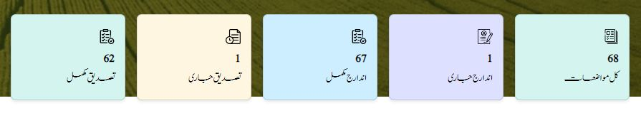
گرداوری رپورٹ تحصیل پنڈی گھیب

Slide 6
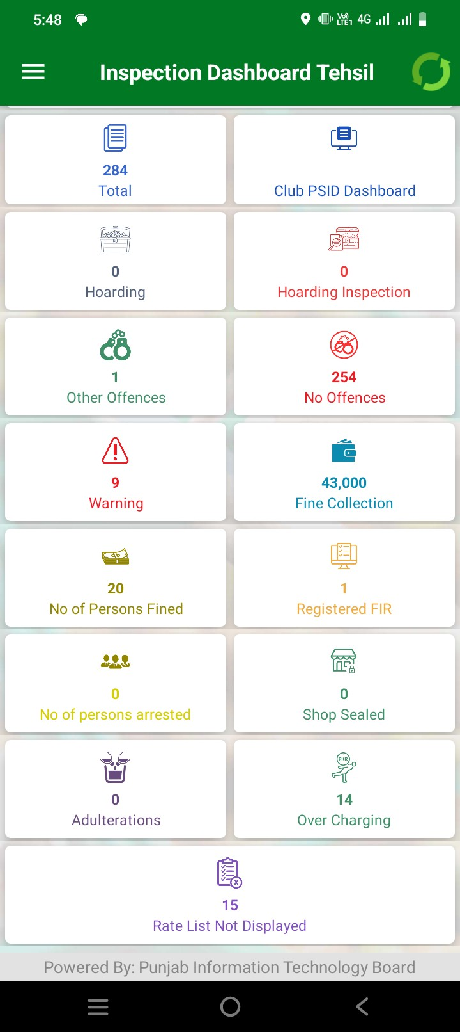
FINE REPORT

Slide 7
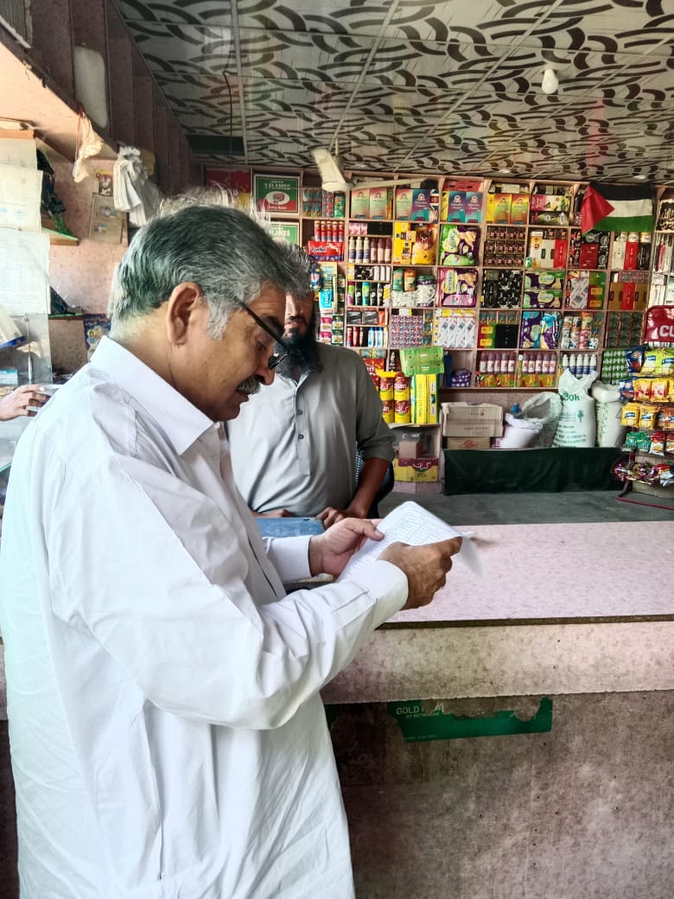
BOR KPI'S PINDIGHEB

Slide 8
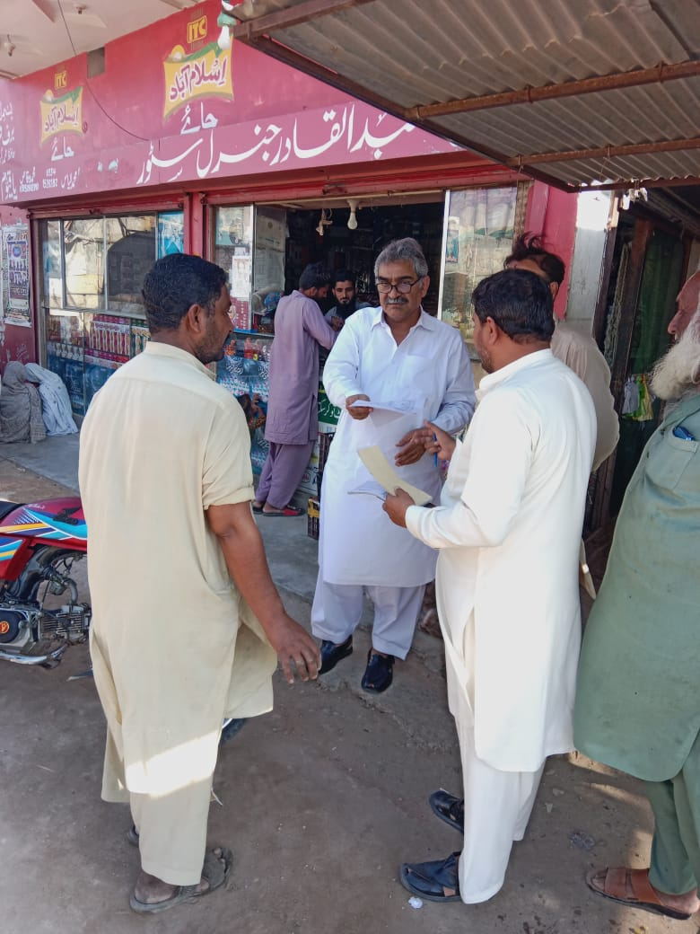
BOR KPI'S PINDIGHEB

Slide 9
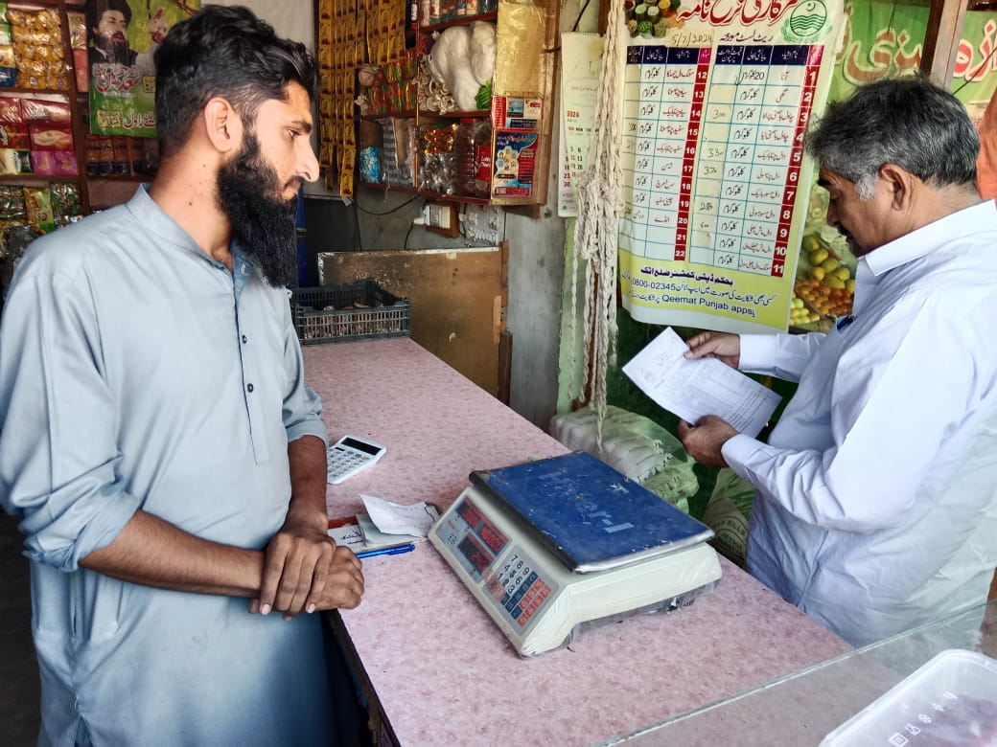
BOR KPI'S PINDIGHEB

Slide 10
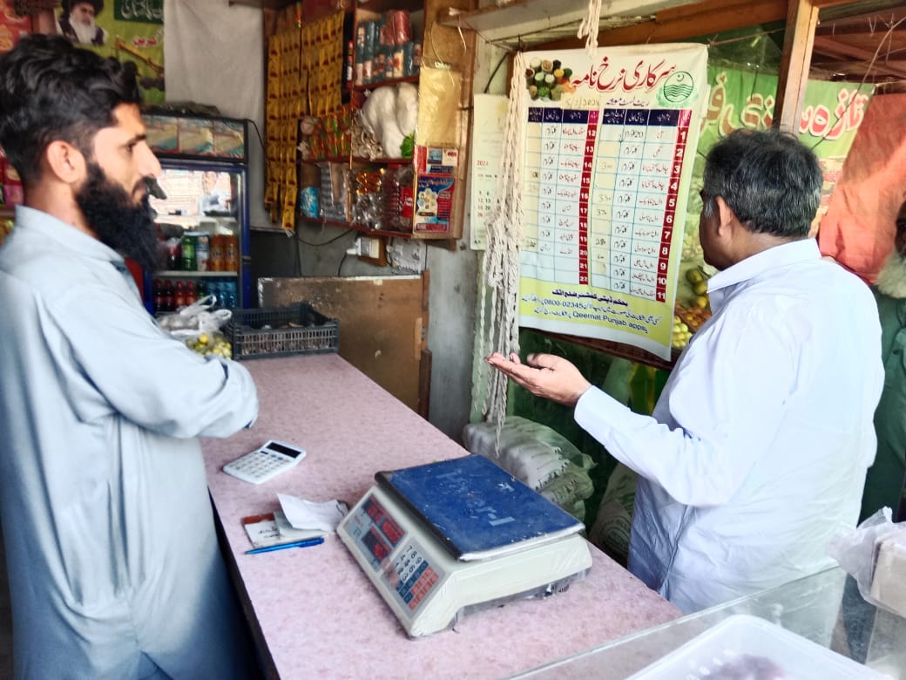
BOR KPI'S PINDIGHEB

Slide 11
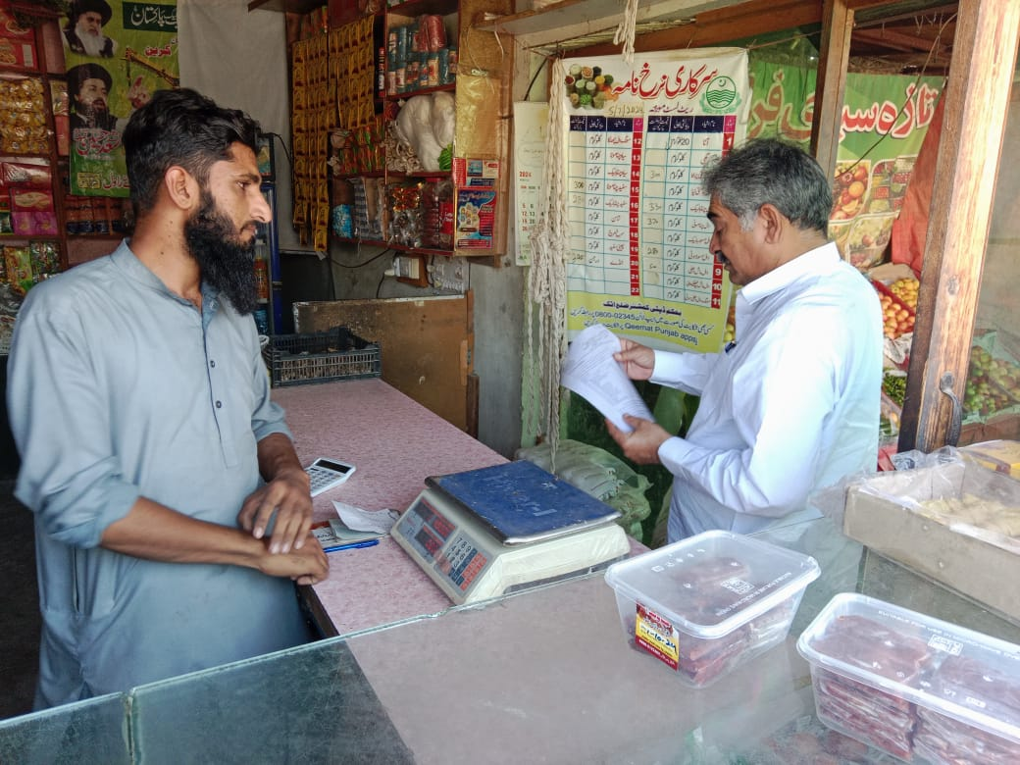
BOR KPI'S PINDIGHEB

Slide 12
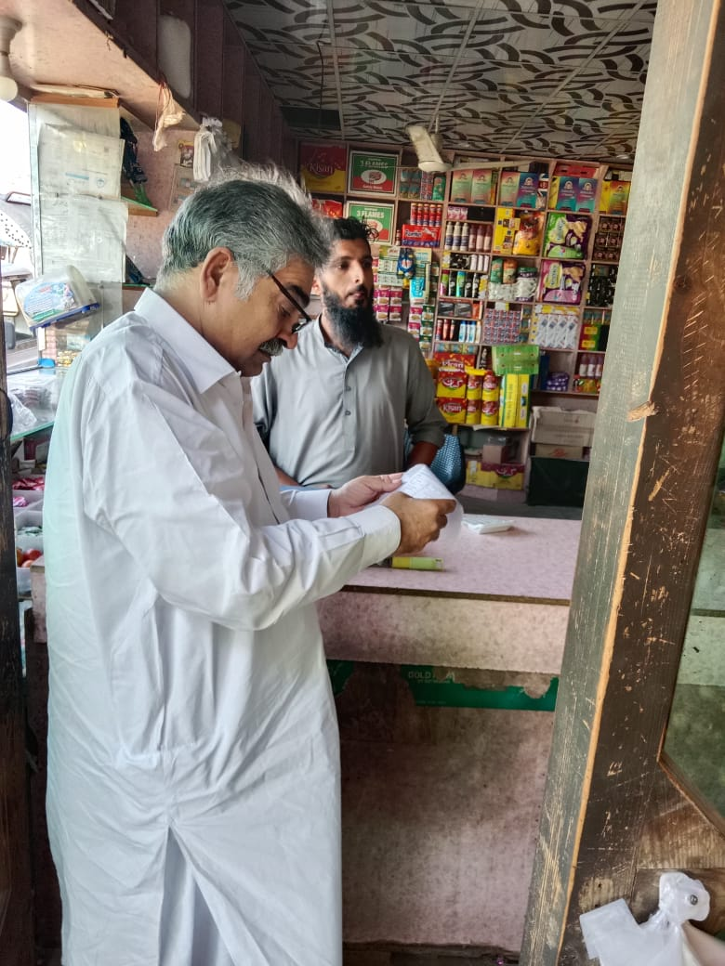
BOR KPI'S PINDIGHEB

Slide 13
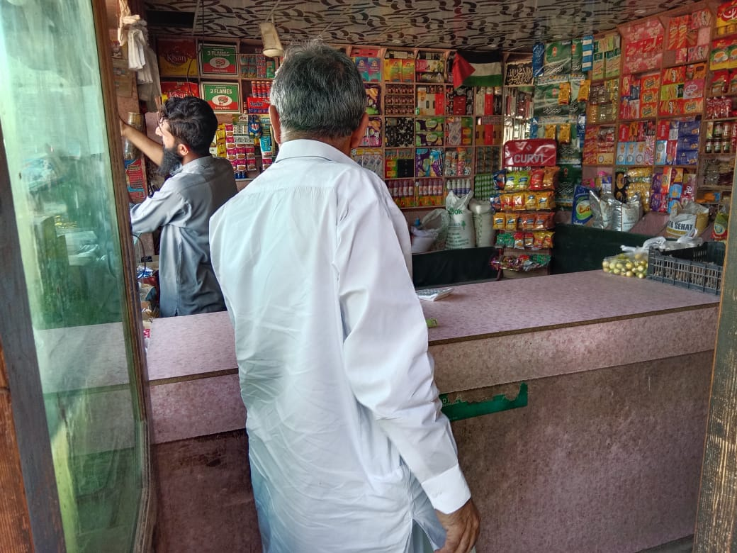
BOR KPI'S PINDIGHEB

Slide 14
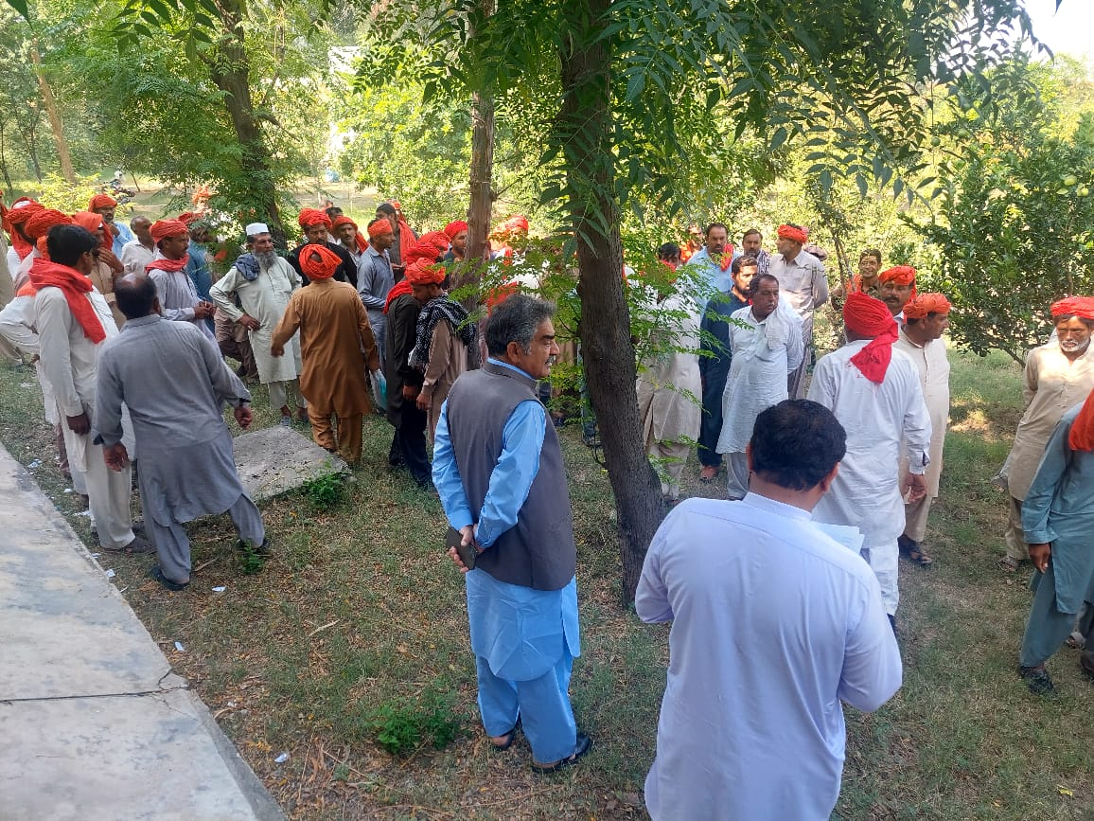
BOR KPI'S PINDIGHEB

Slide 15
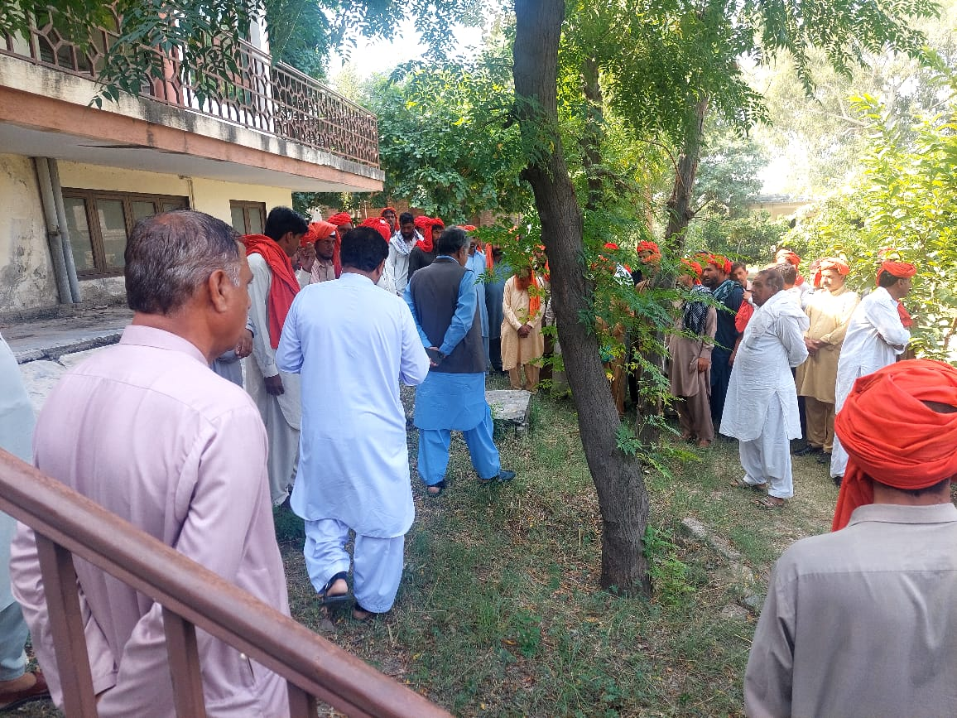
BOR KPI'S PINDIGHEB

Slide 16
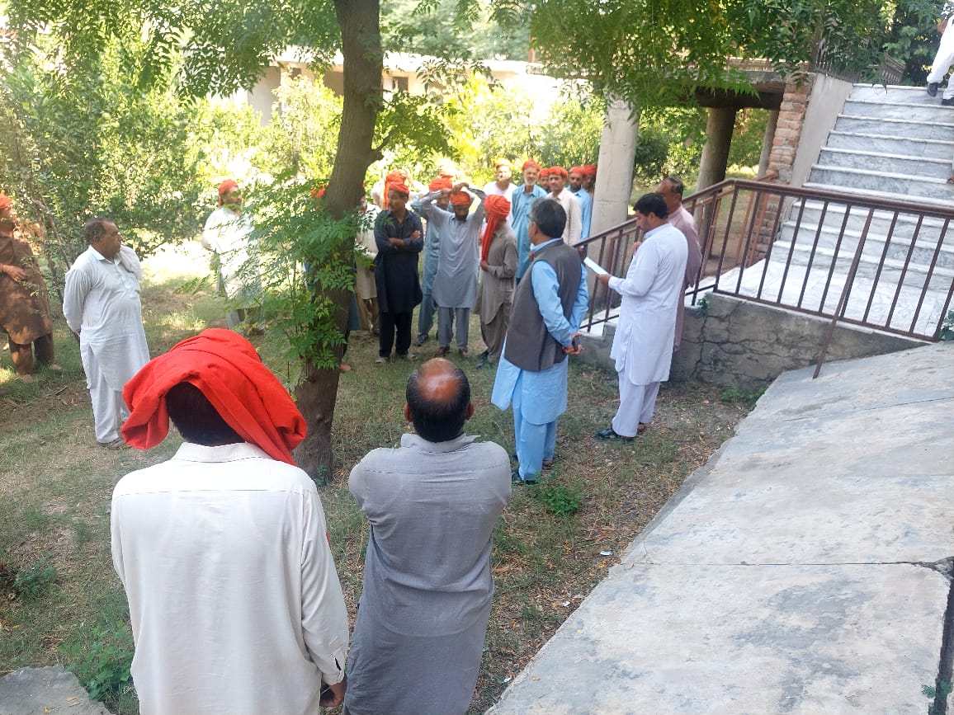
BOR KPI'S PINDIGHEB

Slide 17
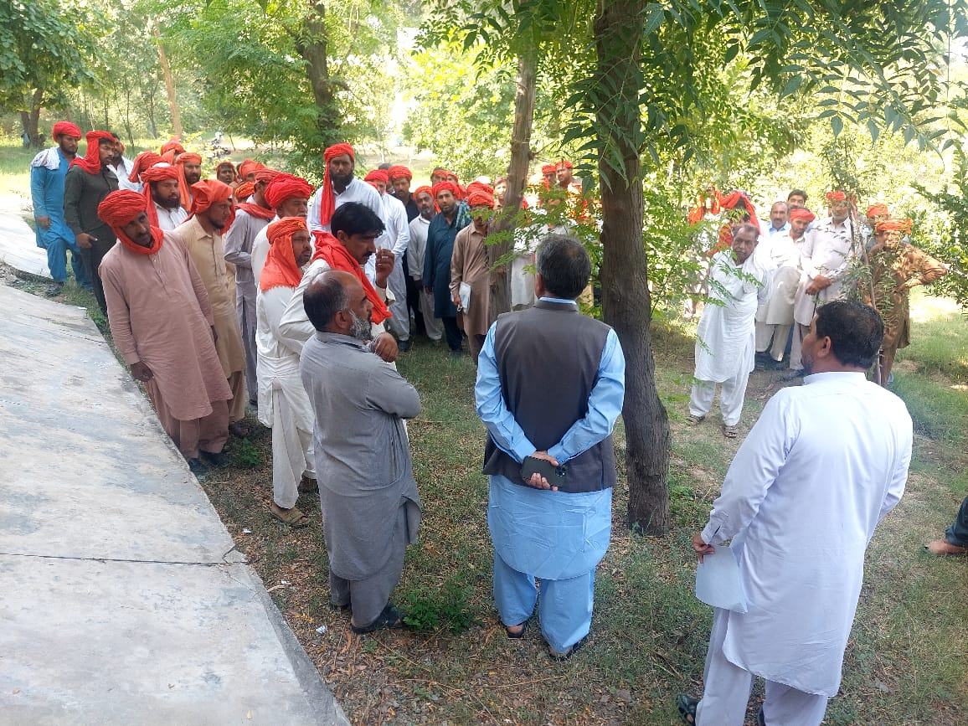
BOR KPI'S PINDIGHEB

Slide 18
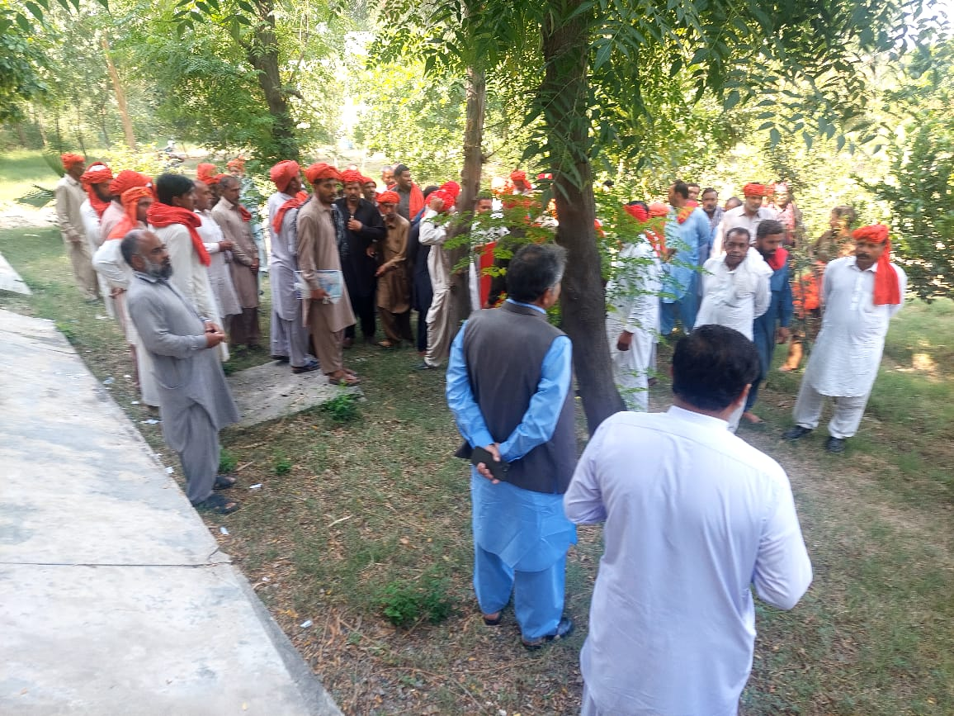
BOR KPI'S PINDIGHEB

Slide 19
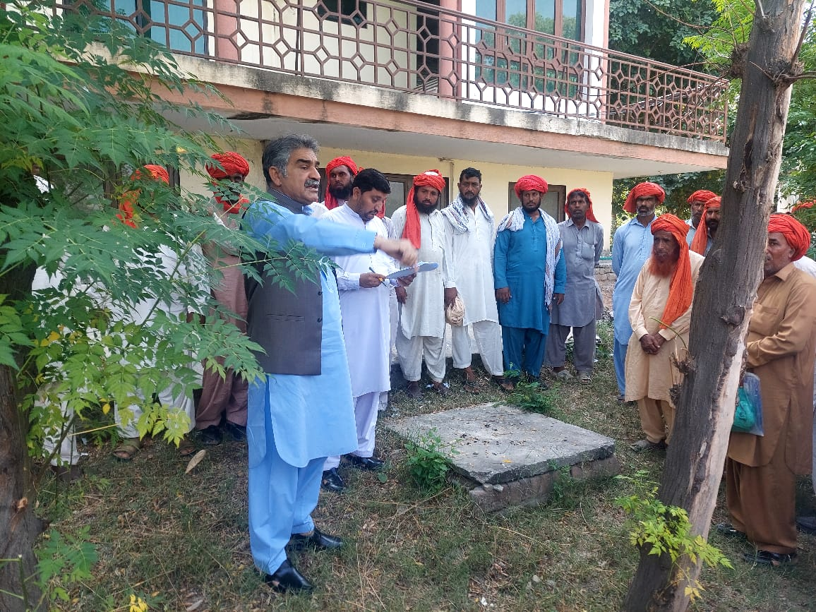
BOR KPI'S PINDIGHEB

Slide 20
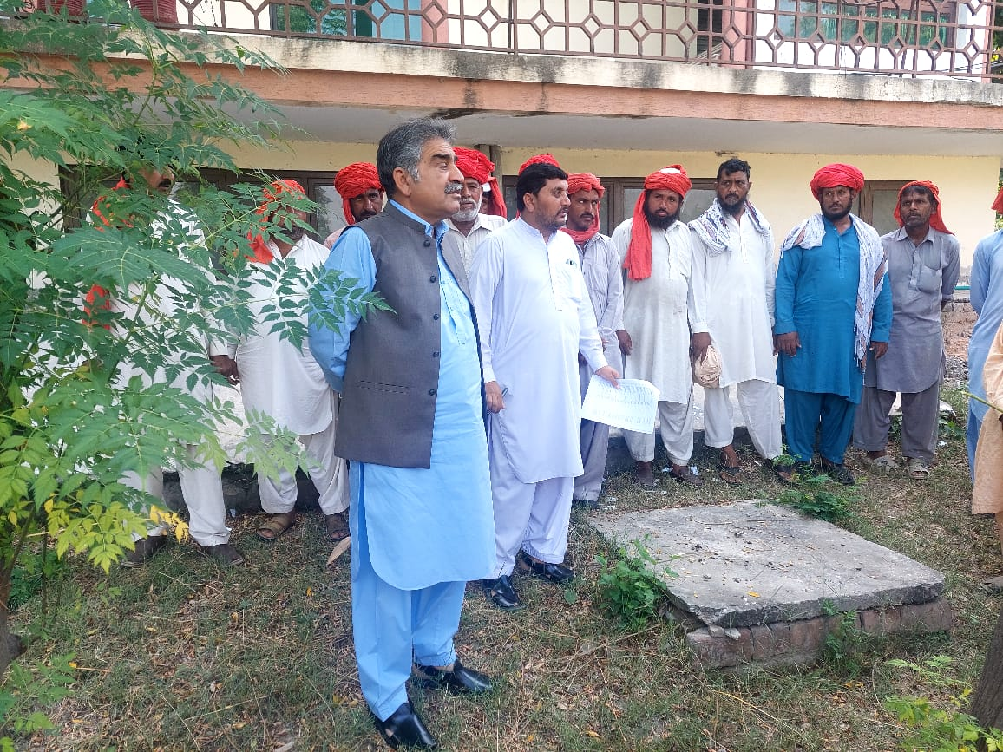
BOR KPI'S PINDIGHEB

Slide 21
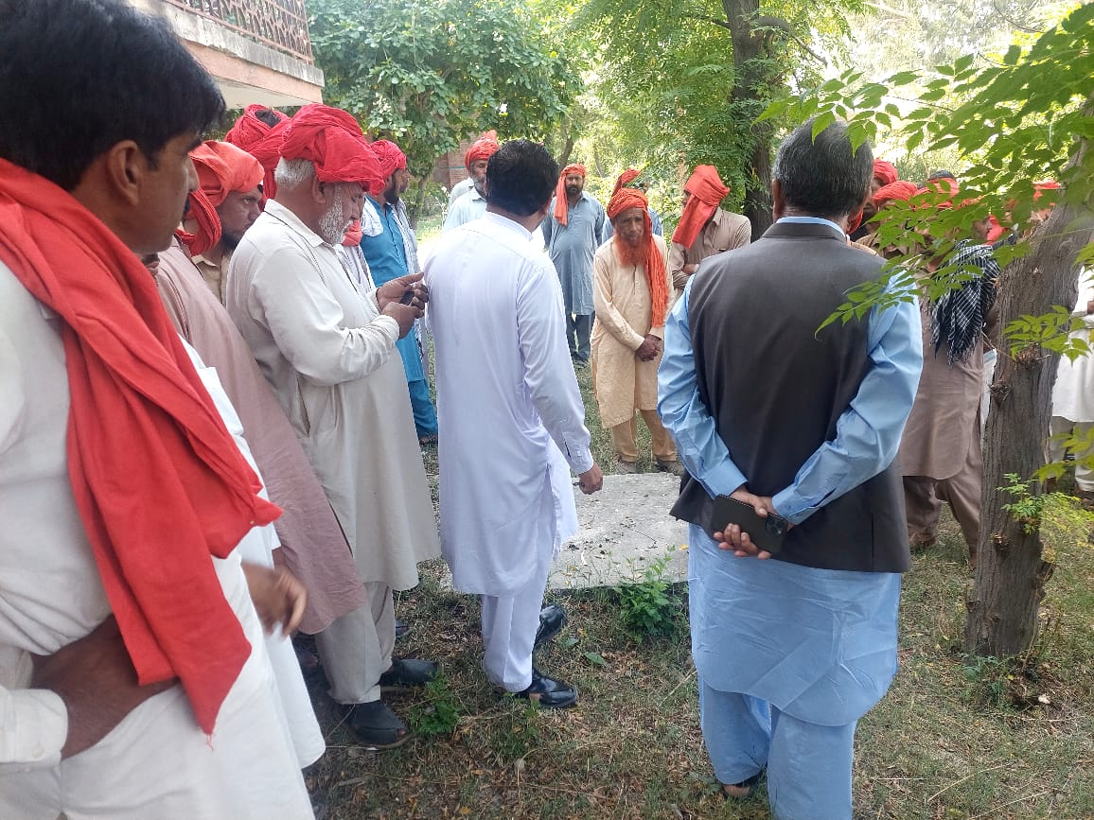
BOR KPI'S PINDIGHEB

Slide 22
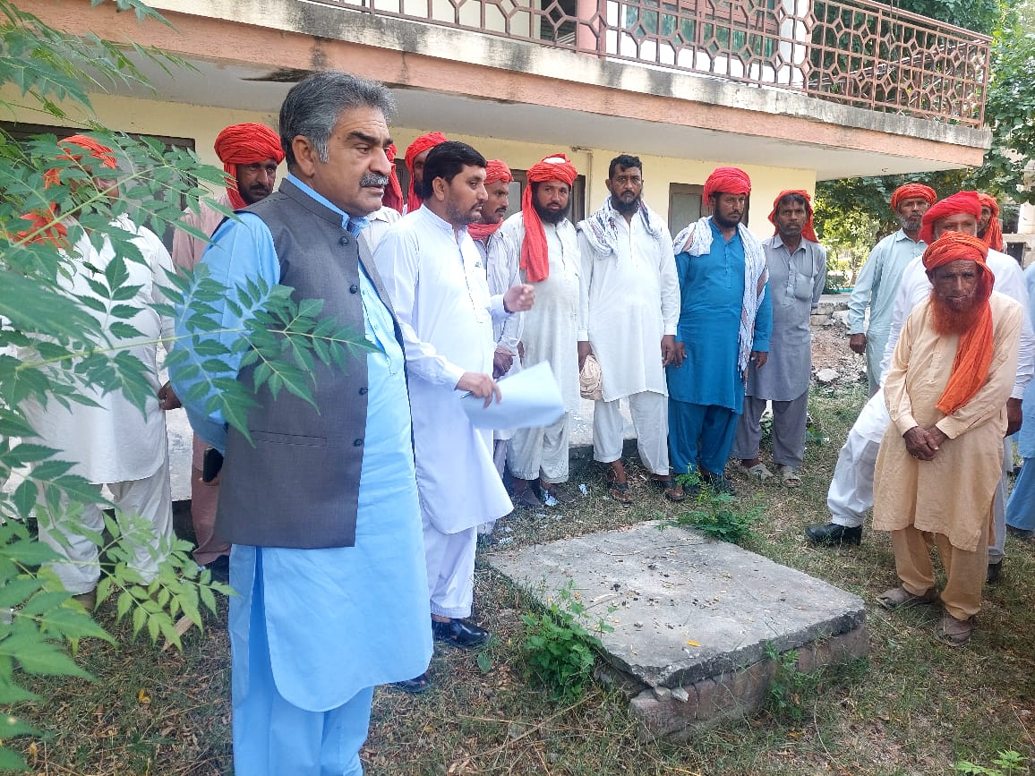
BOR KPI'S PINDIGHEB

Slide 23
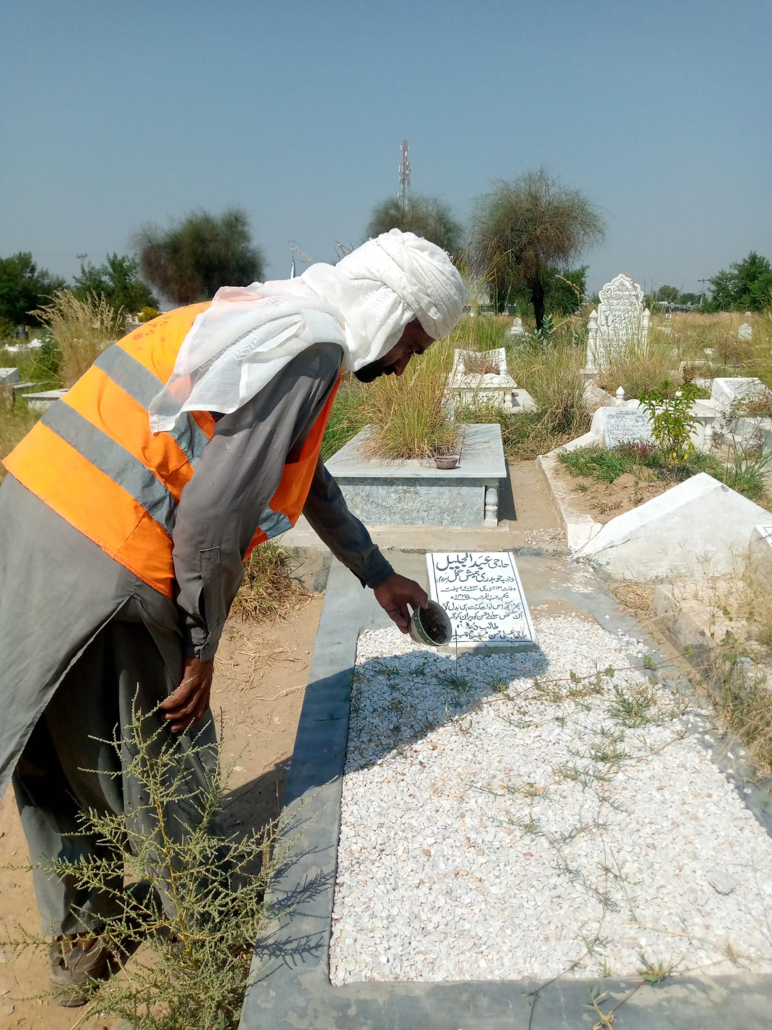
BOR KPI'S PINDIGHEB

Slide 24
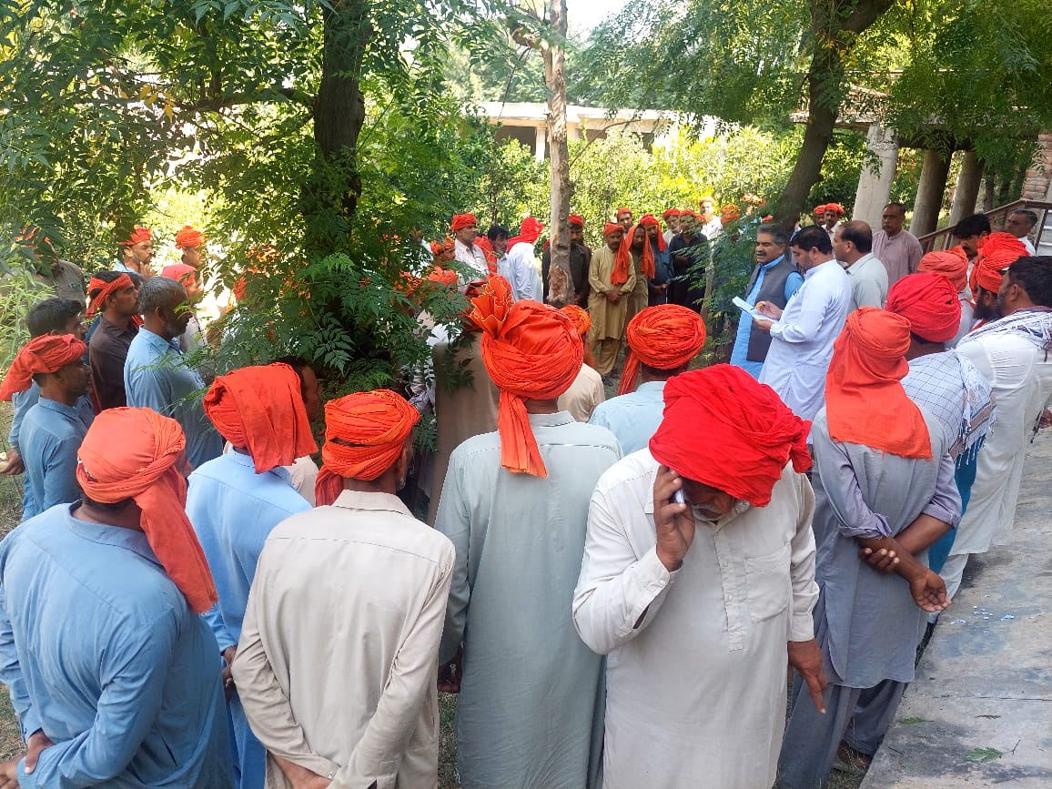
BOR KPI'S PINDIGHEB

Slide 25
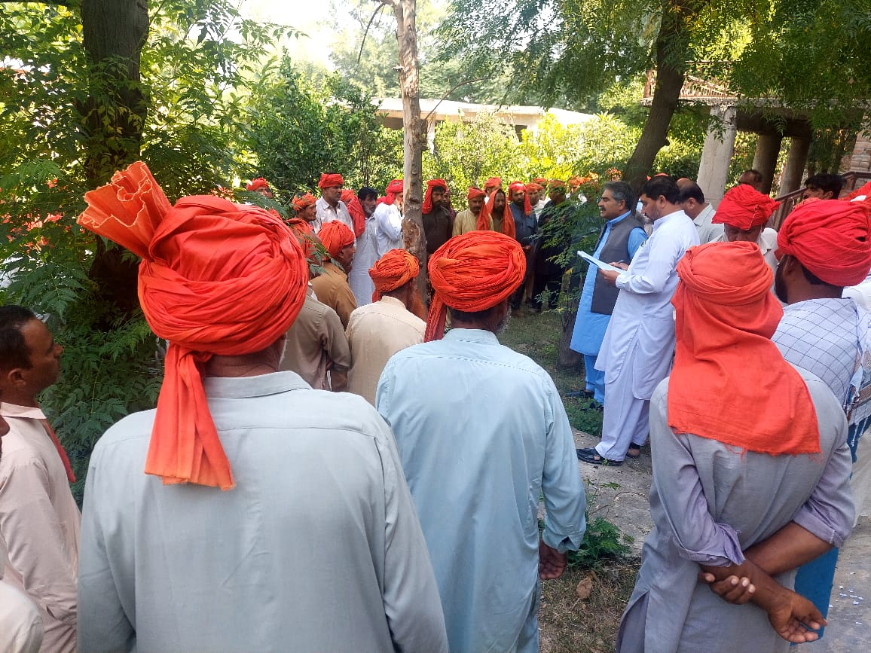
BOR KPI'S PINDIGHEB

Slide 26
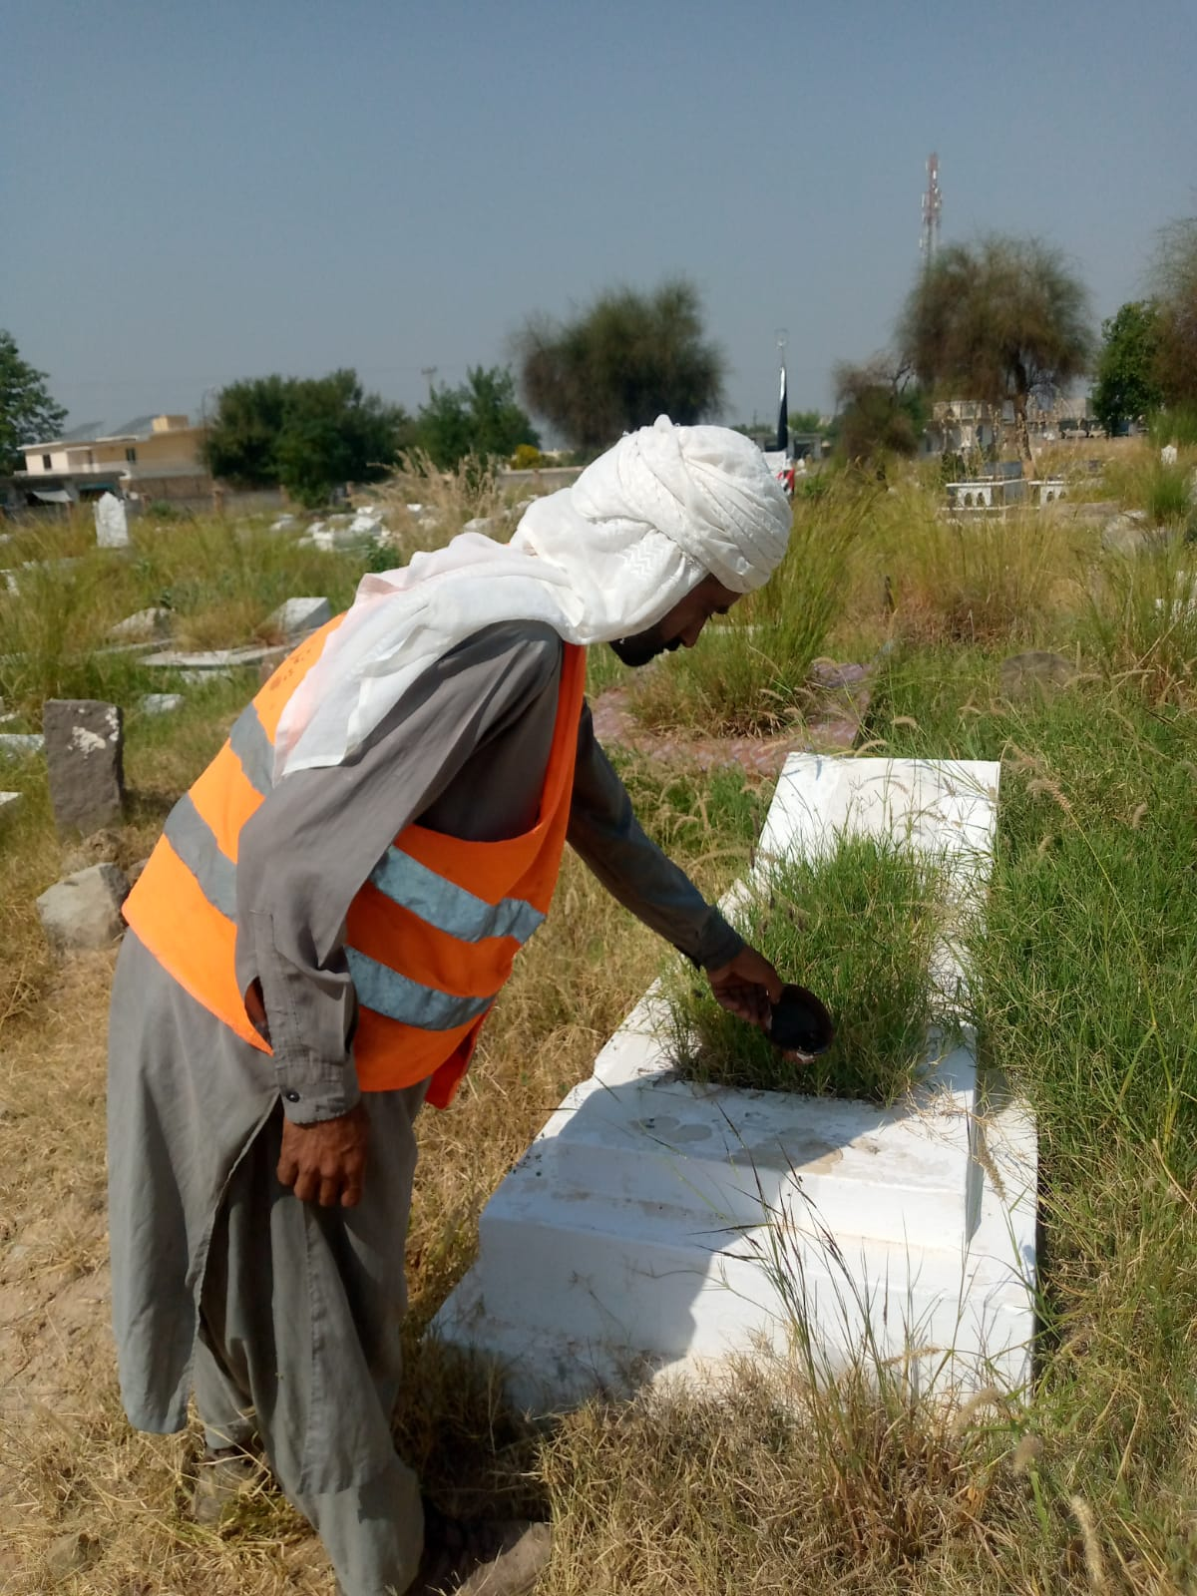
BOR KPI'S PINDIGHEB

Slide 27
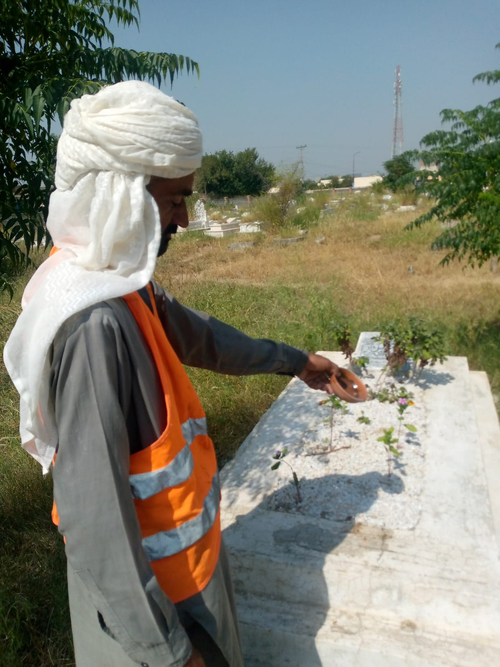
BOR KPI'S PINDIGHEB

Slide 28
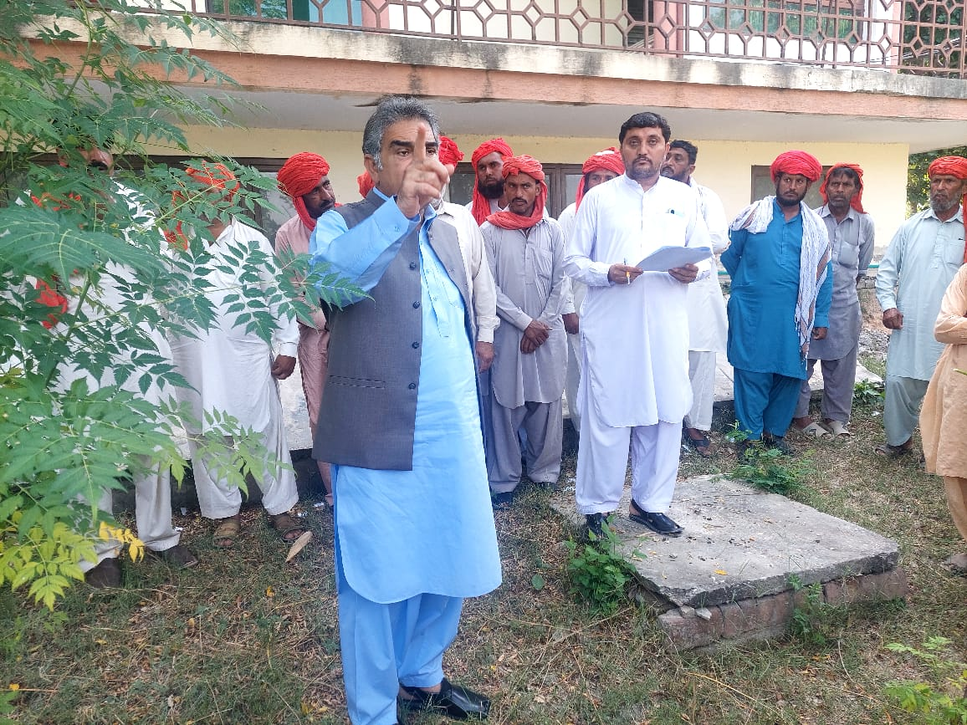
BOR KPI'S PINDIGHEB

Slide 29
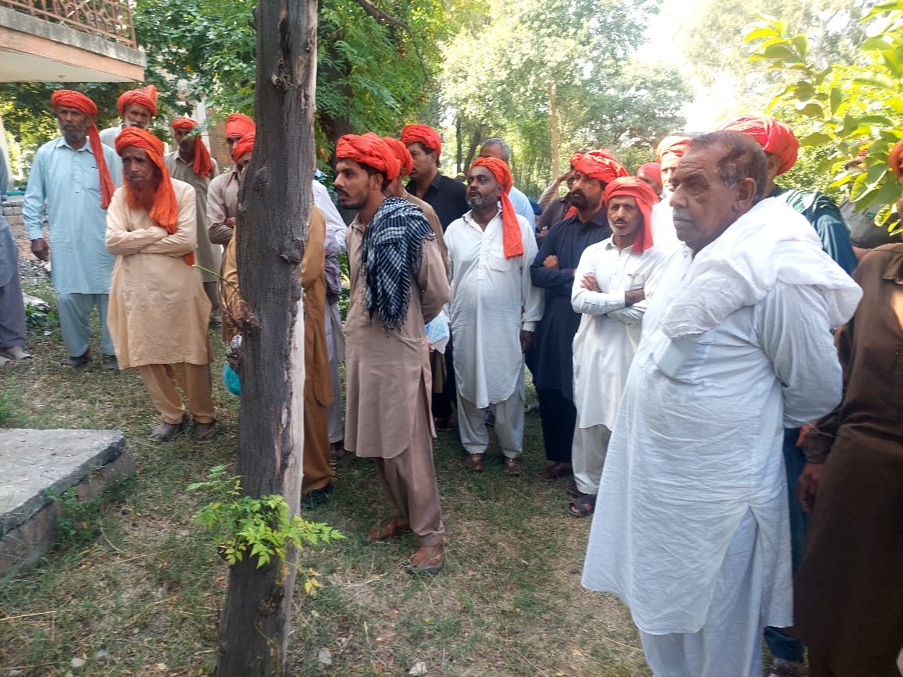
BOR KPI'S PINDIGHEB

Slide 30
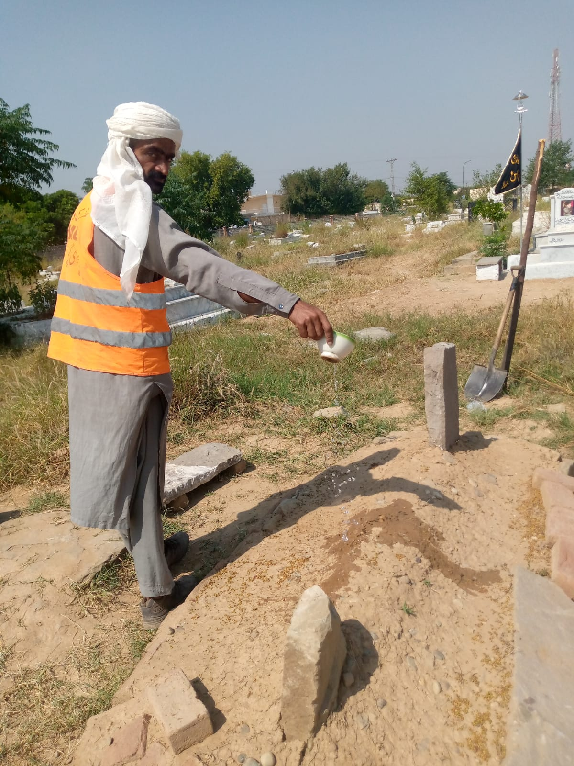
BOR KPI'S PINDIGHEB

Slide 31
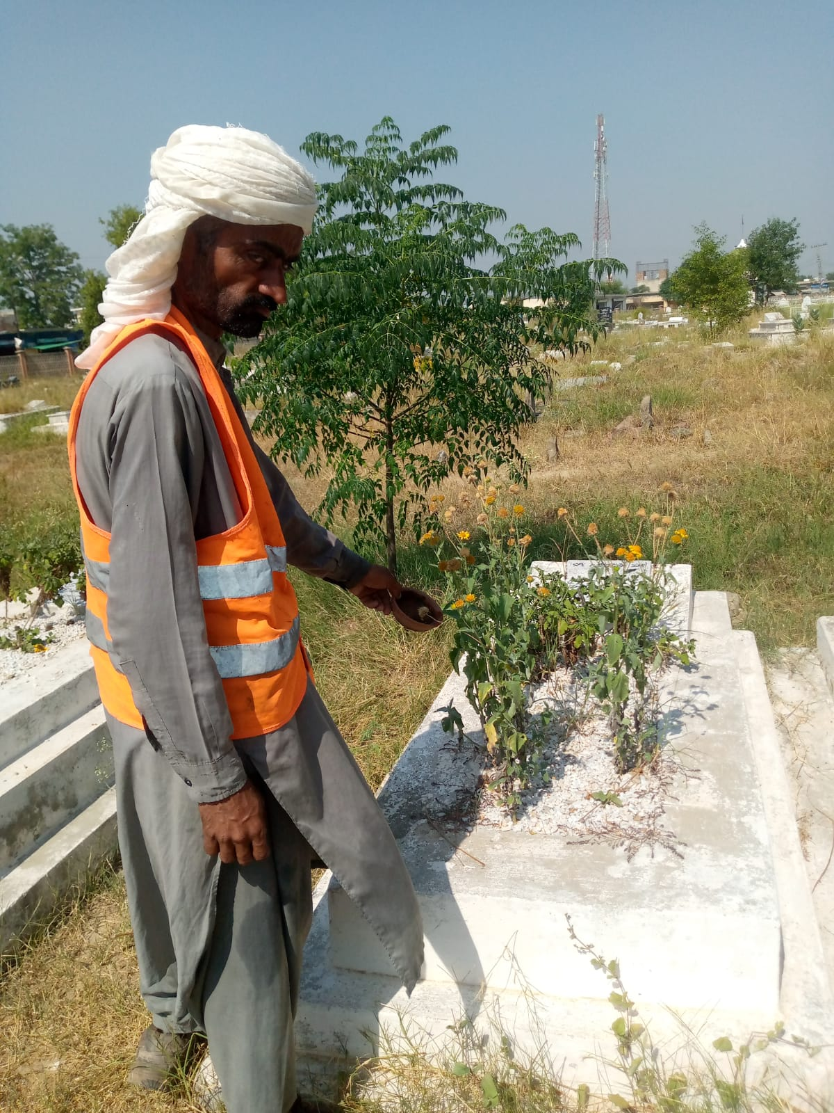
BOR KPI'S PINDIGHEB

Slide 32
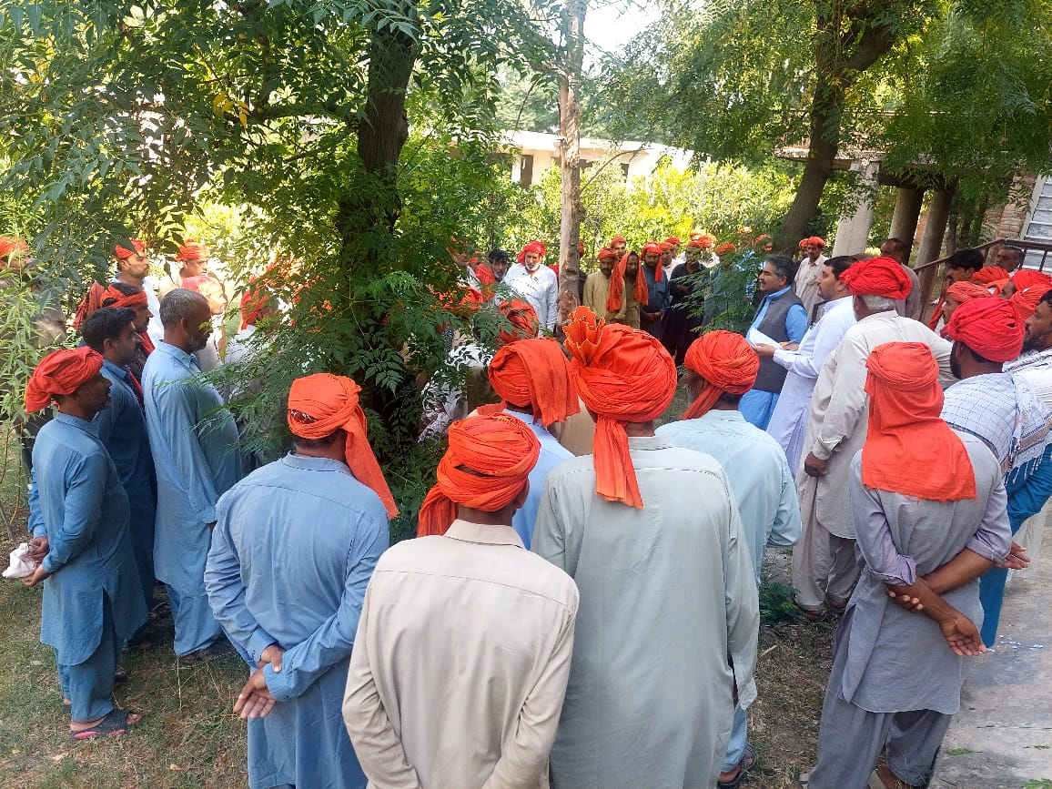
BOR KPI'S PINDIGHEB

Slide 33
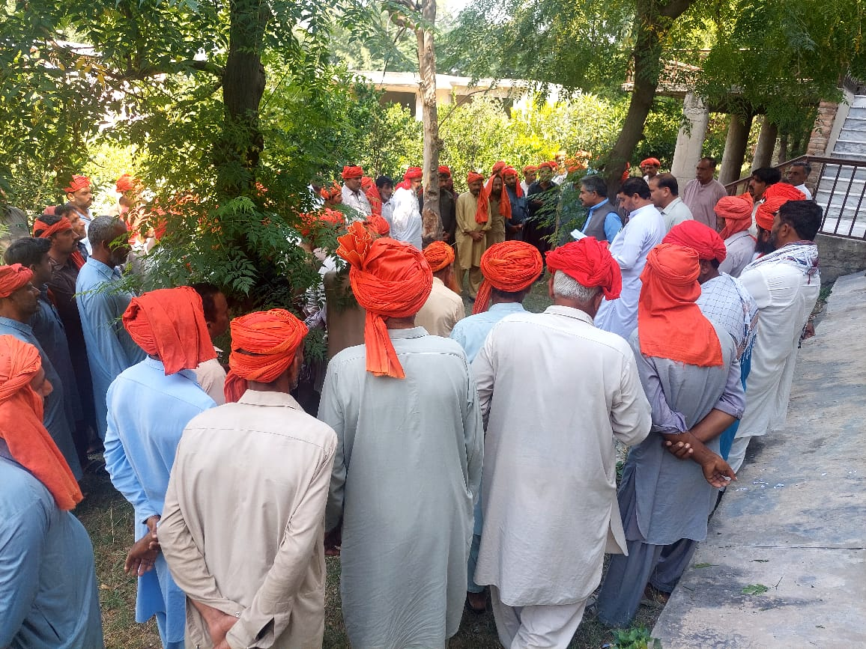
BOR KPI'S PINDIGHEB

Slide 34
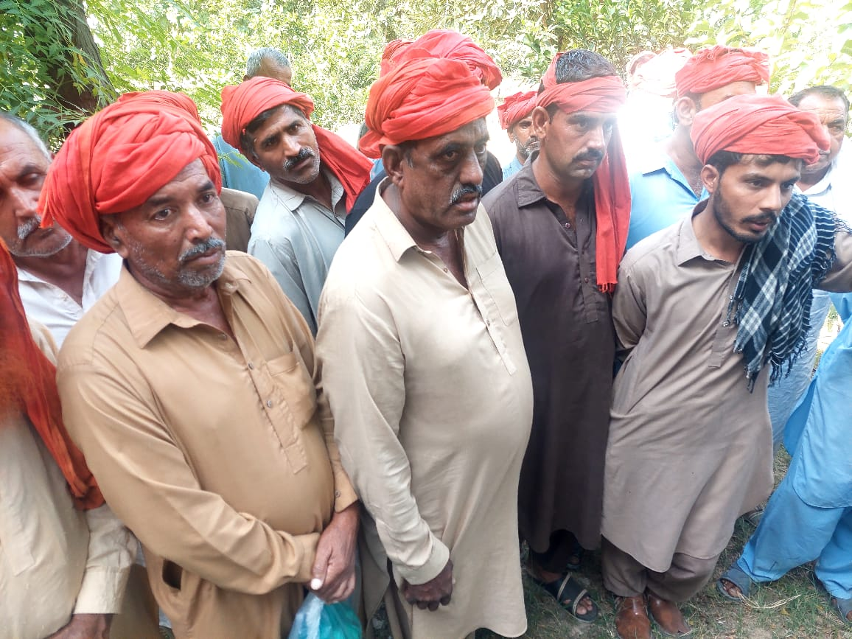
BOR KPI'S PINDIGHEB

Slide 35
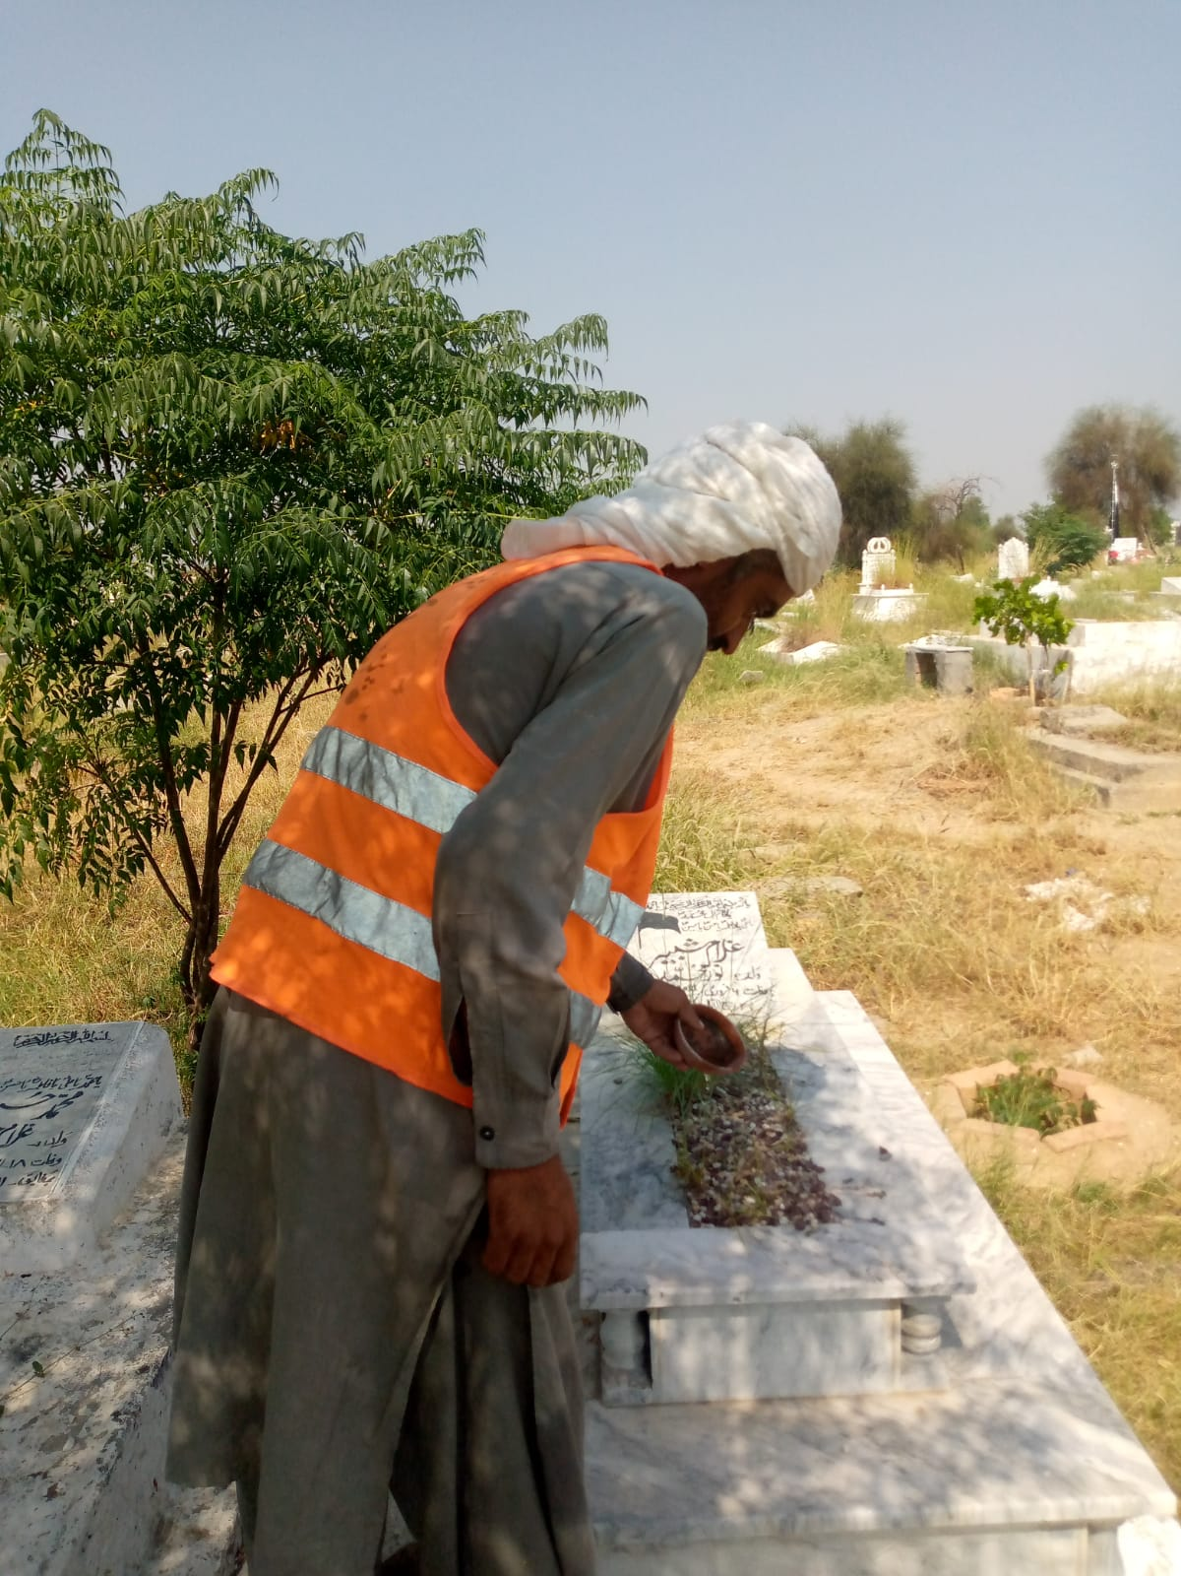
BOR KPI'S PINDIGHEB

Slide 36
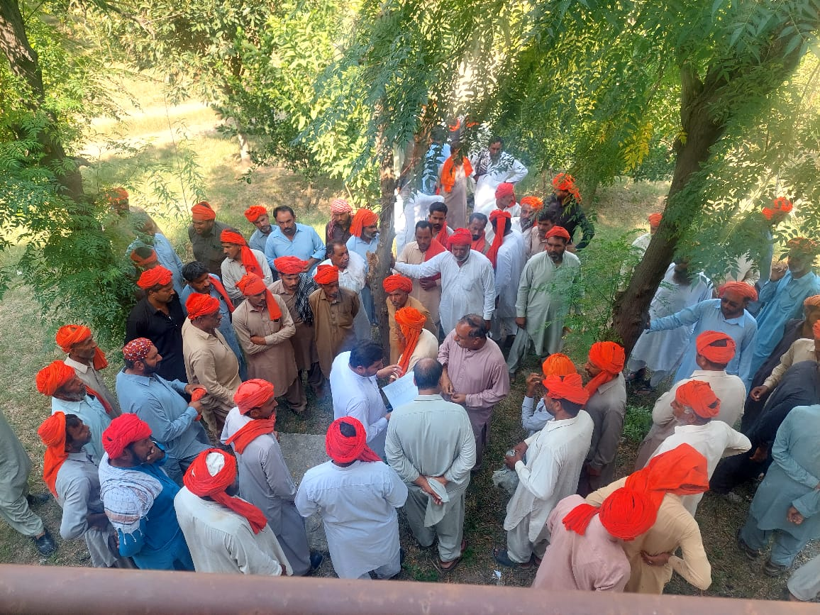
BOR KPI'S PINDIGHEB

Slide 37
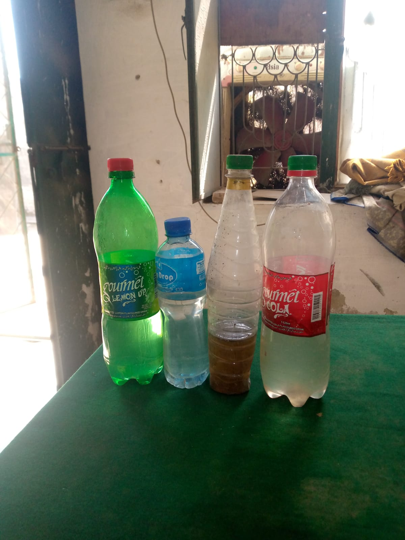
BOR KPI'S PINDIGHEB

Slide 38
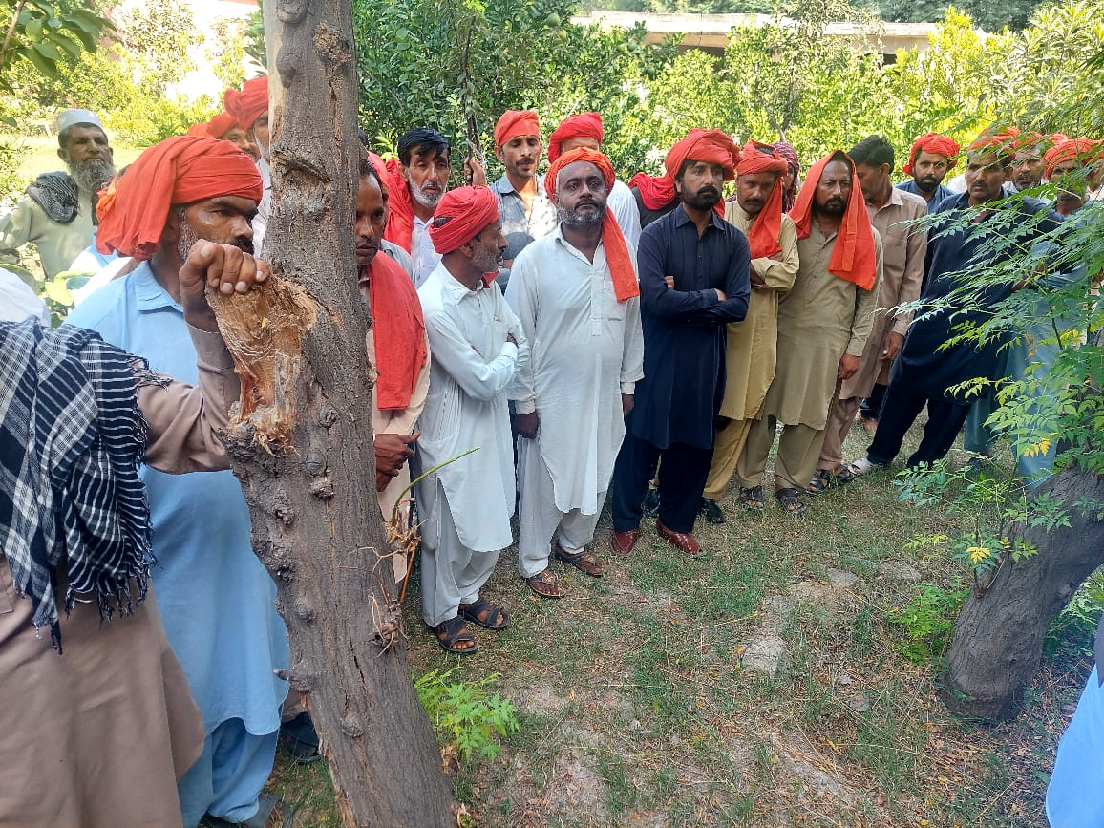
BOR KPI'S PINDIGHEB

Slide 39
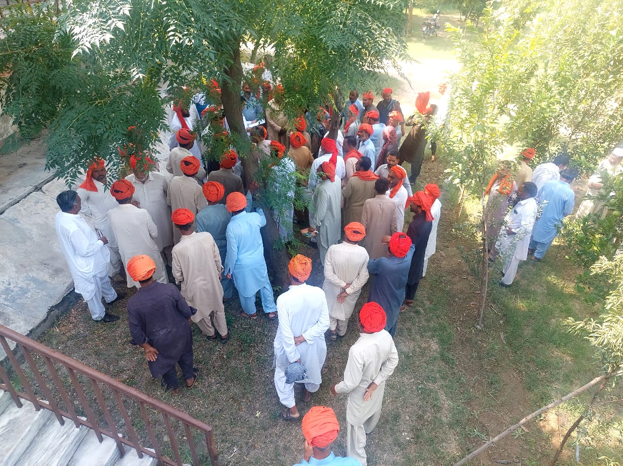
BOR KPI'S PINDIGHEB

Slide 40
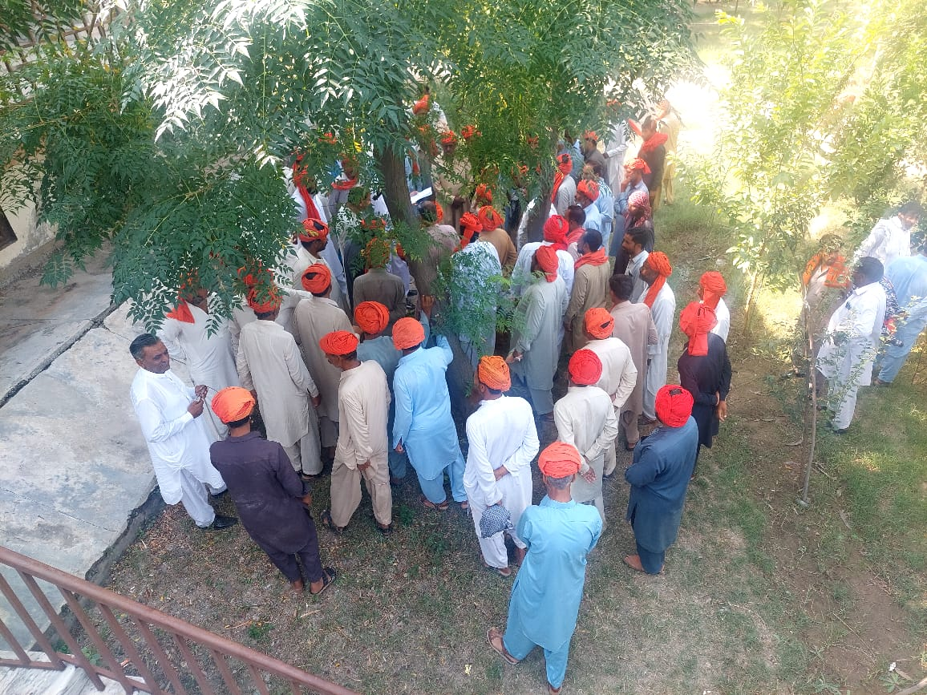
BOR KPI'S PINDIGHEB

Slide 41
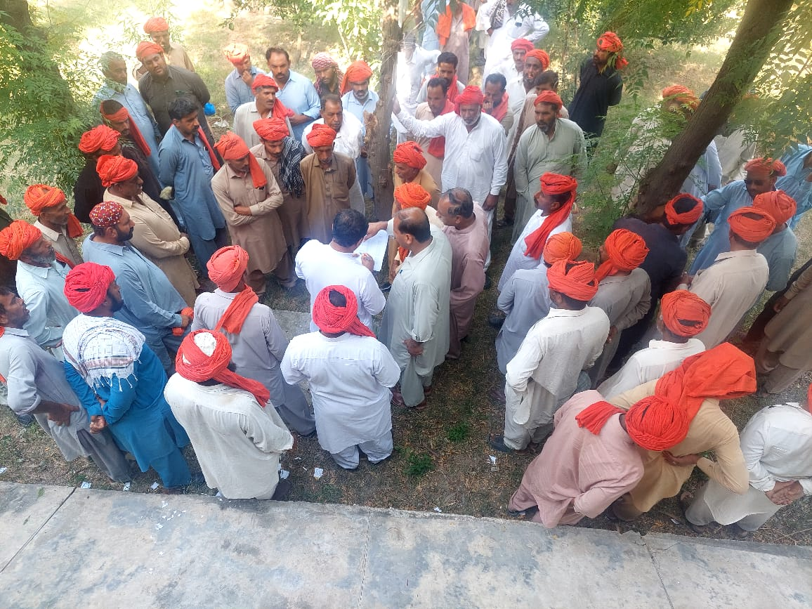
BOR KPI'S PINDIGHEB

Slide 42
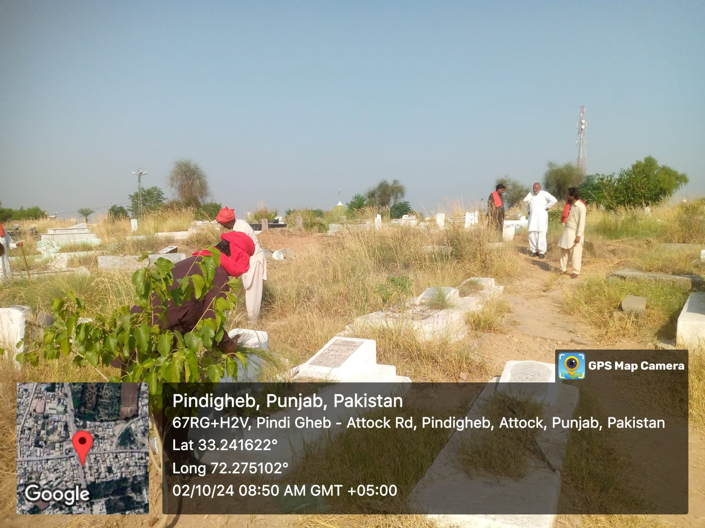
Cleanliness Inspection

Slide 43
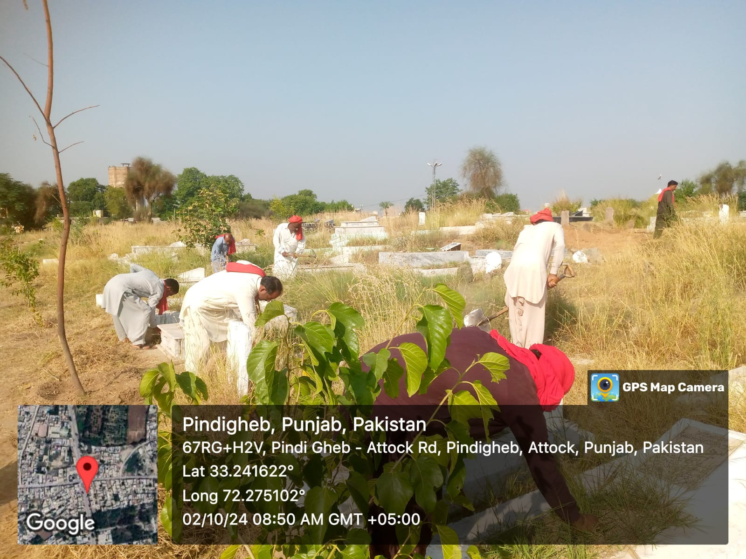
Cleanliness Inspection

Slide 44
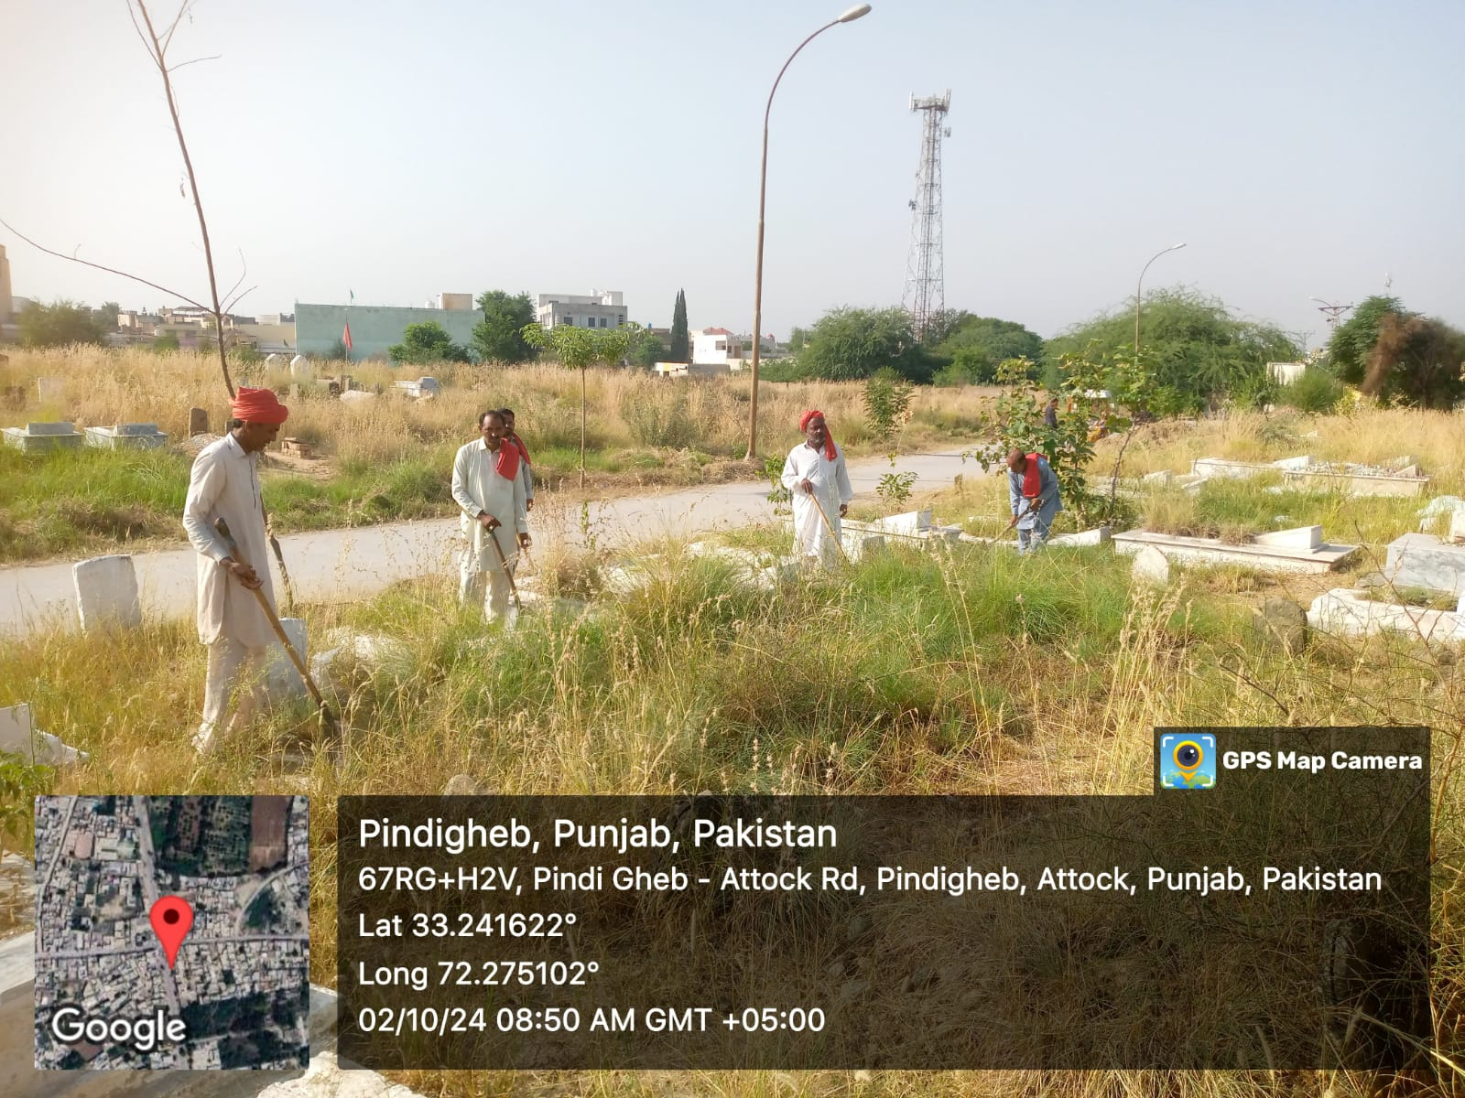
Cleanliness Inspection

Slide 45
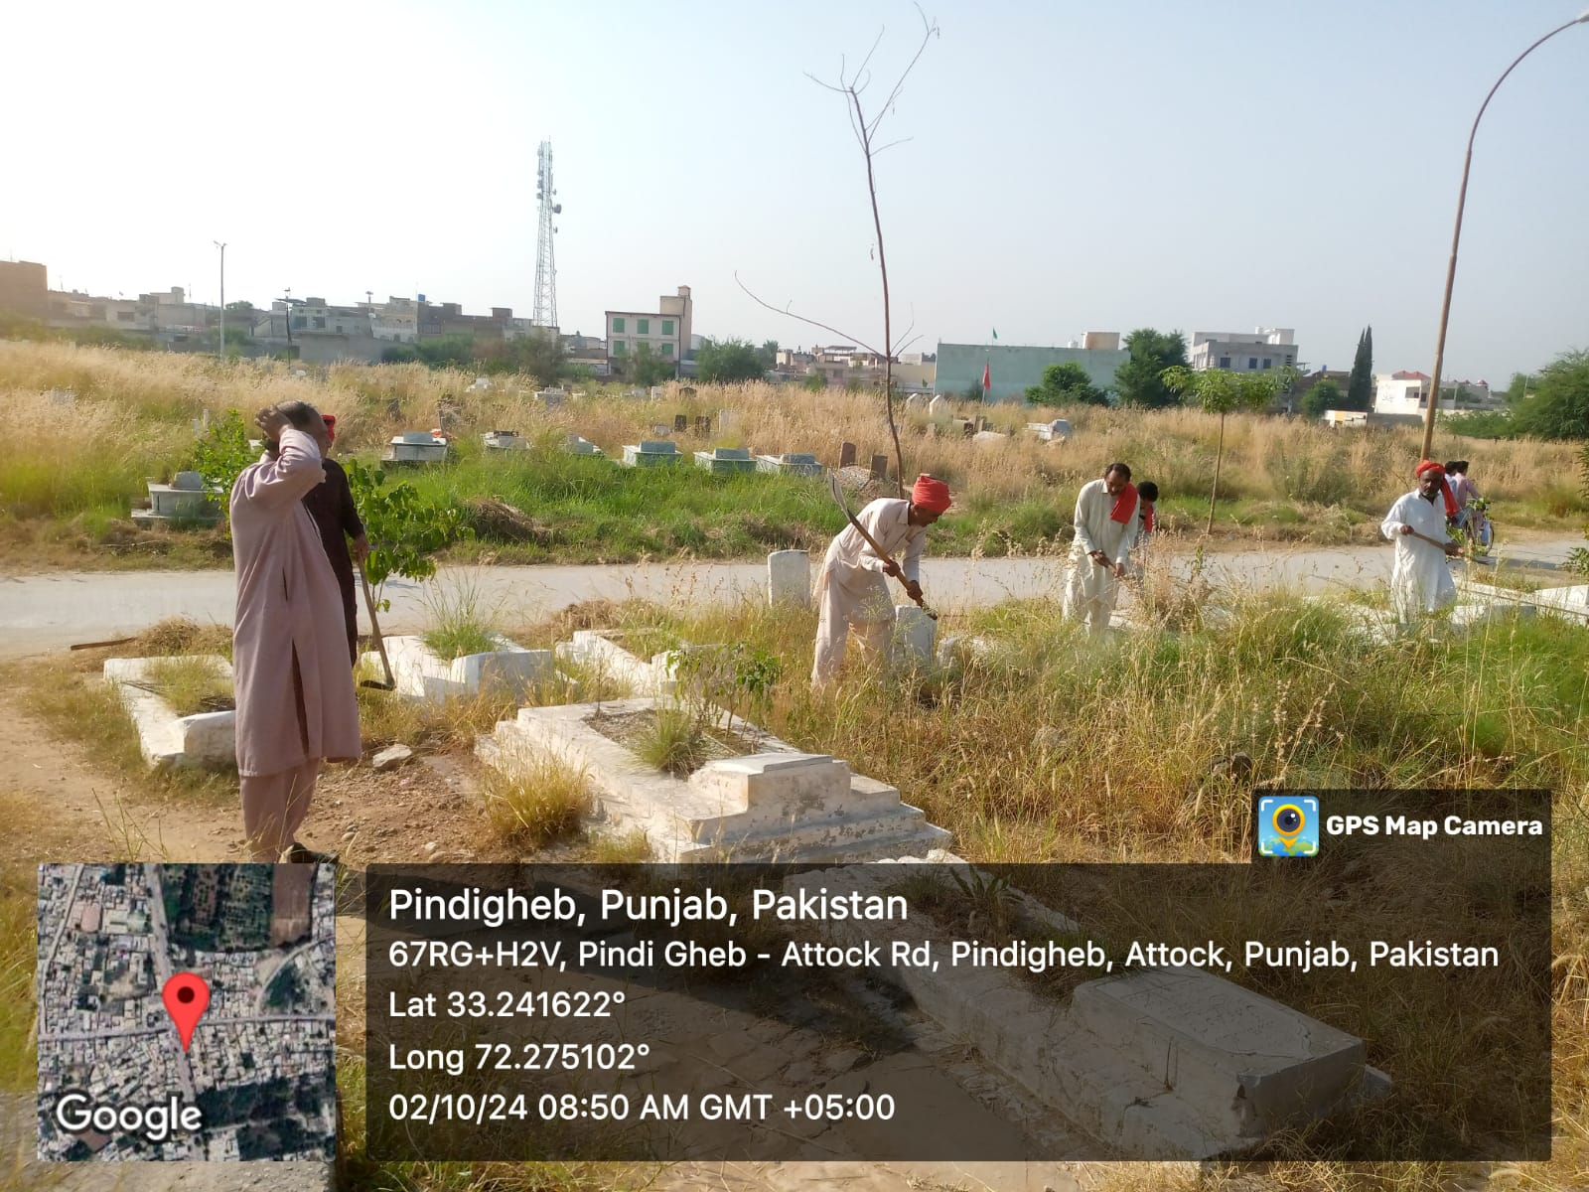
Cleanliness Inspection

Slide 46
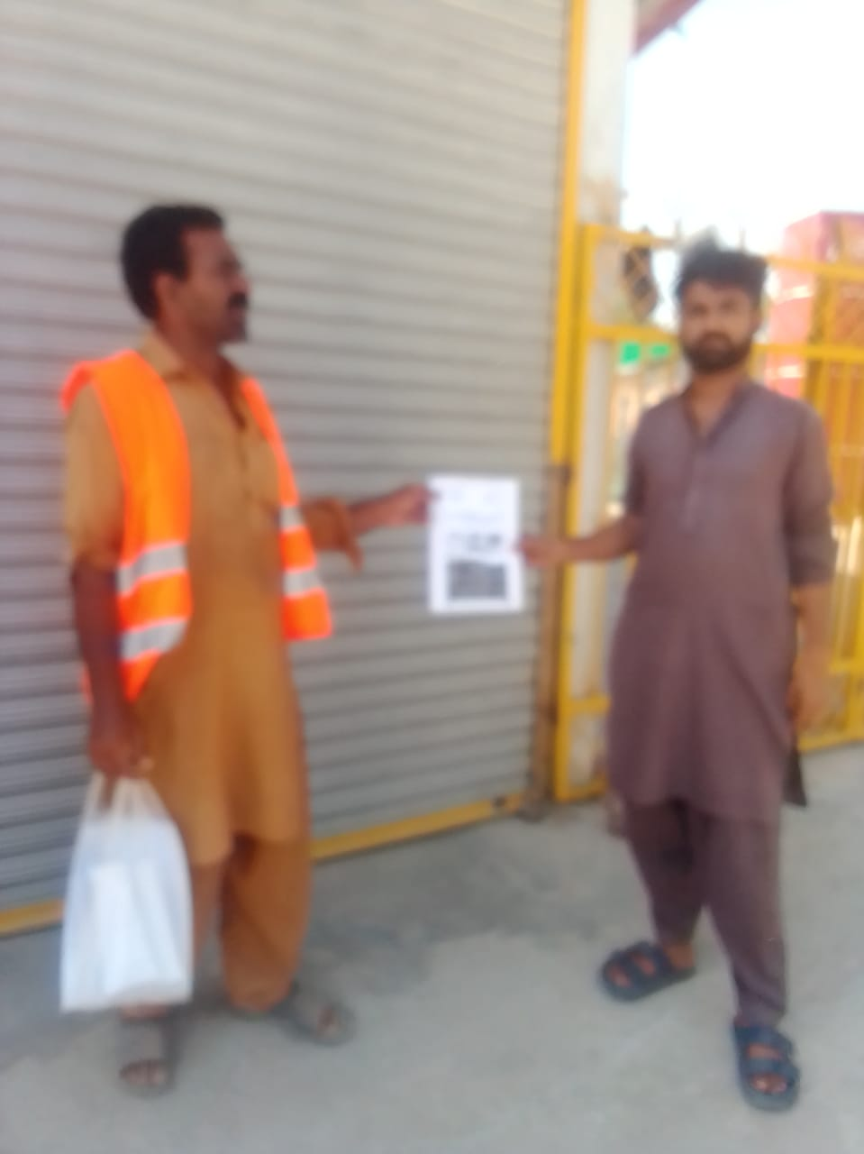
CAMPAIGN Against Dengue

Slide 47
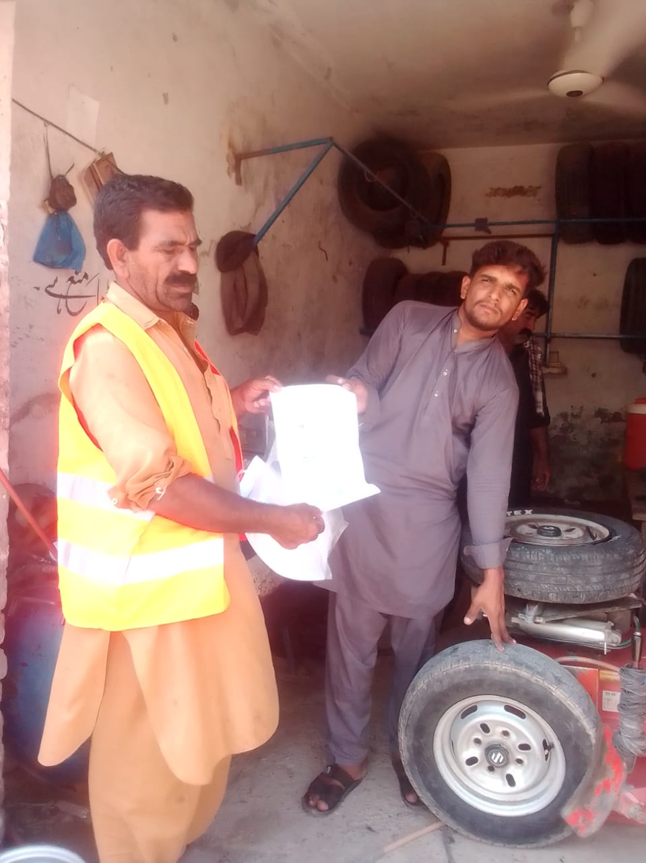
CAMPAIGN Against Dengue

Slide 48
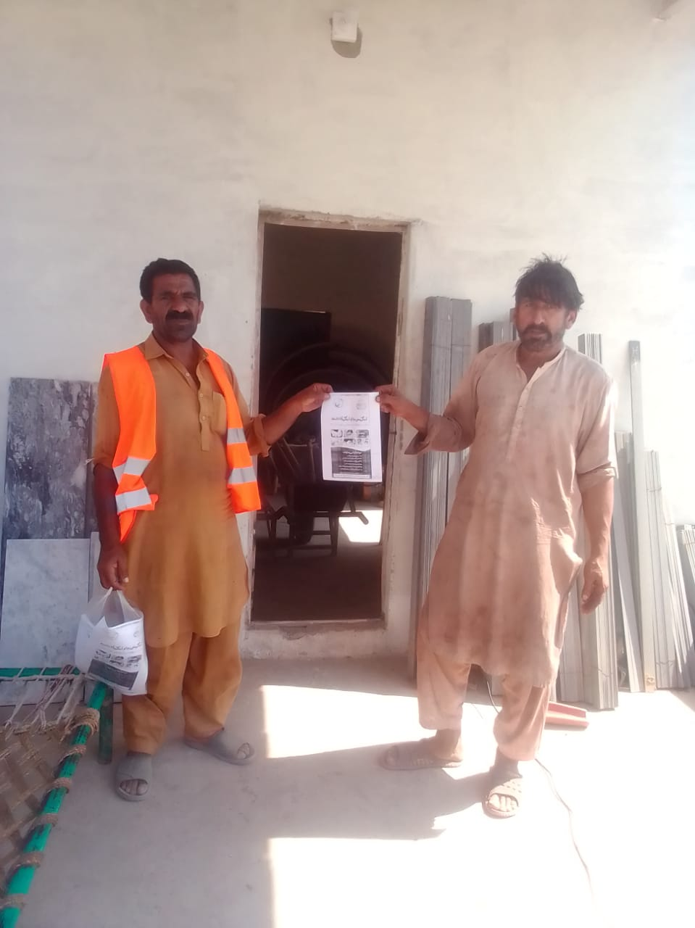
CAMPAIGN Against Dengue

Slide 49
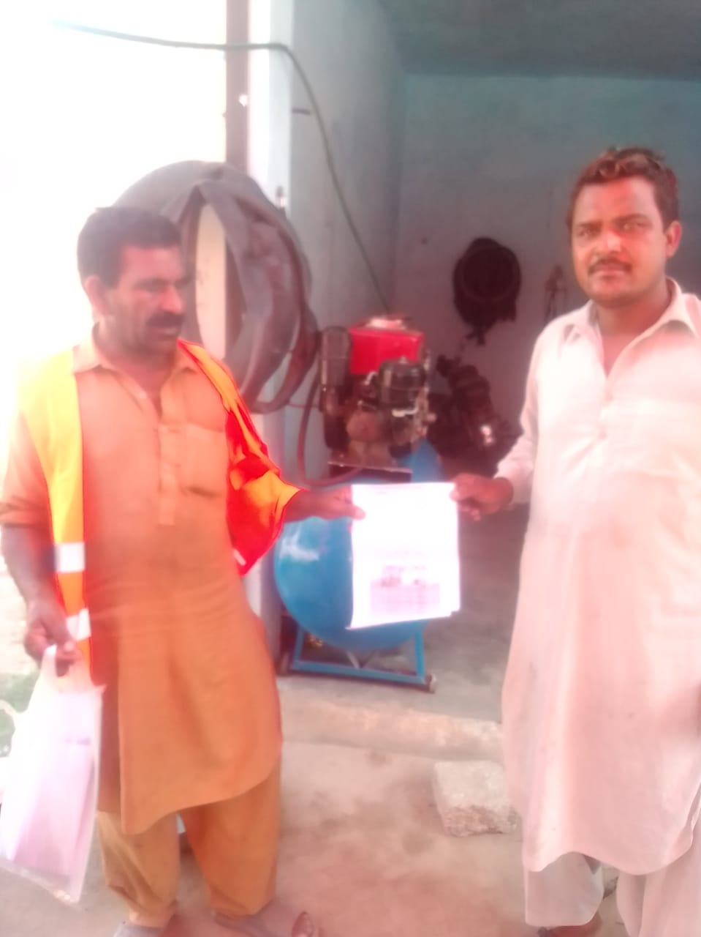
CAMPAIGN Against Dengue

Slide 50
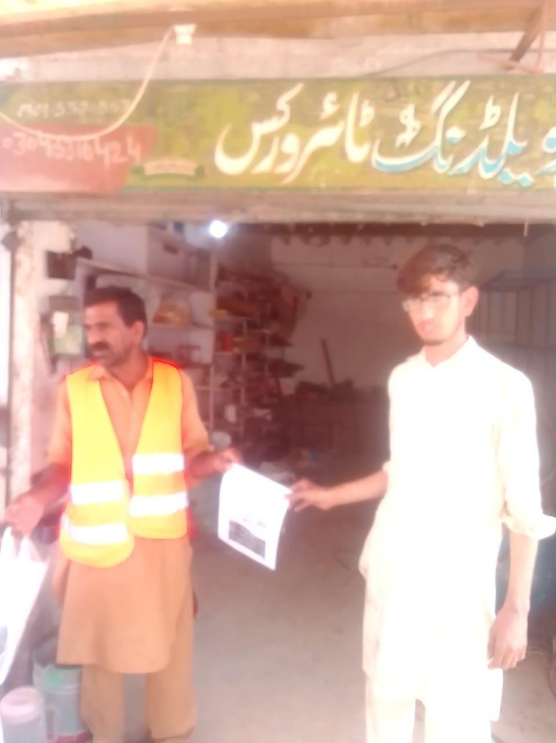
CAMPAIGN Against Dengue

Slide 51
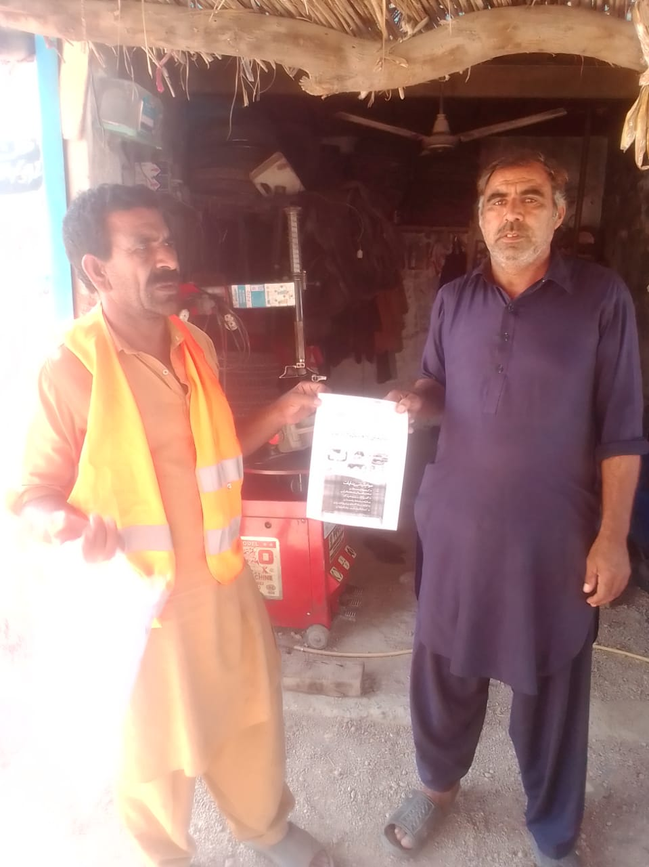
CAMPAIGN Against Dengue

Slide 52
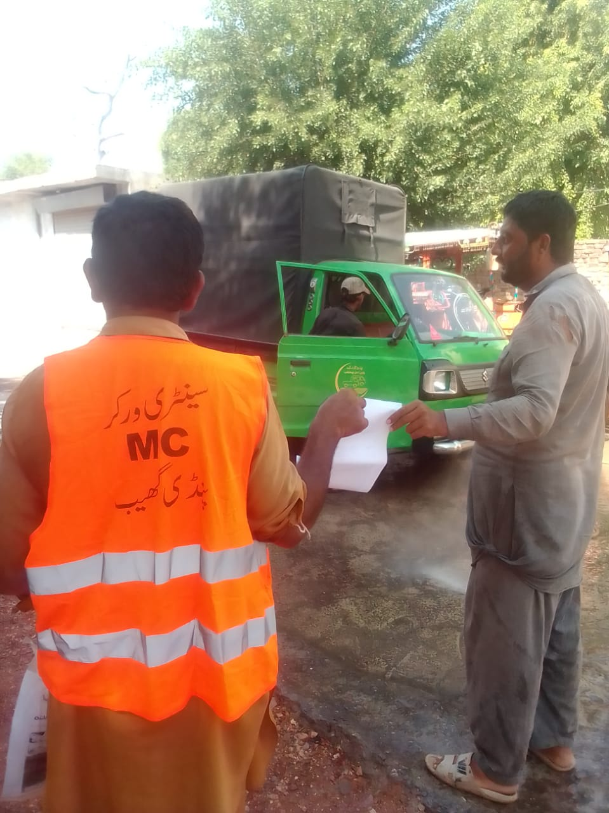
CAMPAIGN Against Dengue

Slide 53
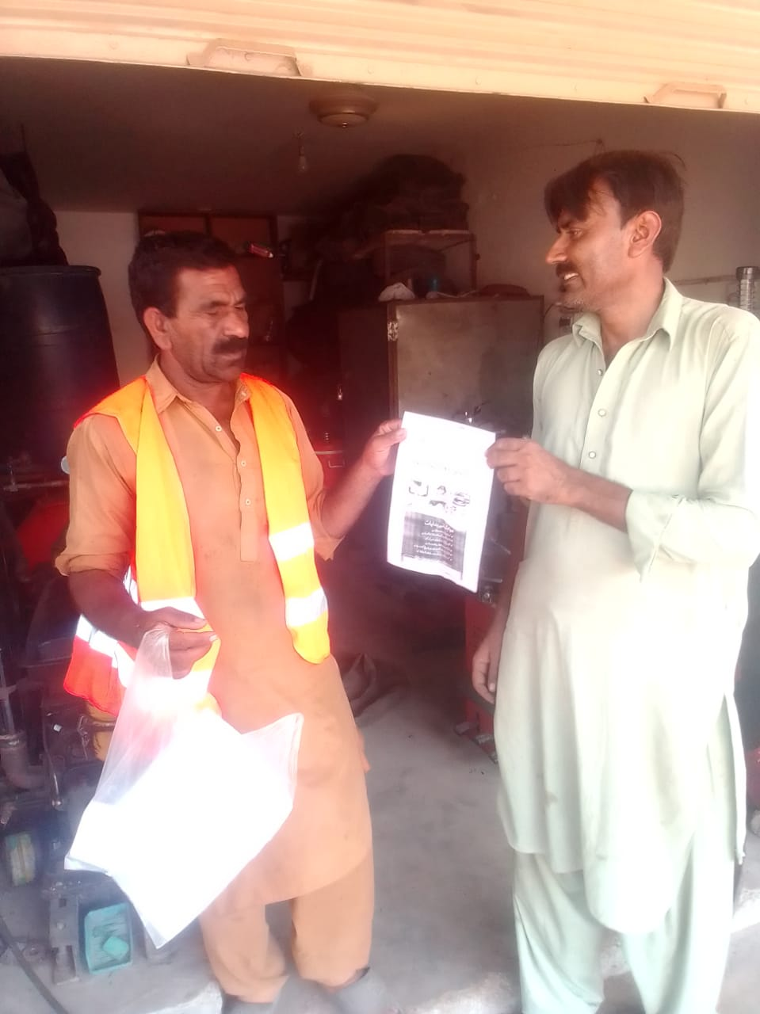
CAMPAIGN Against Dengue

Slide 54
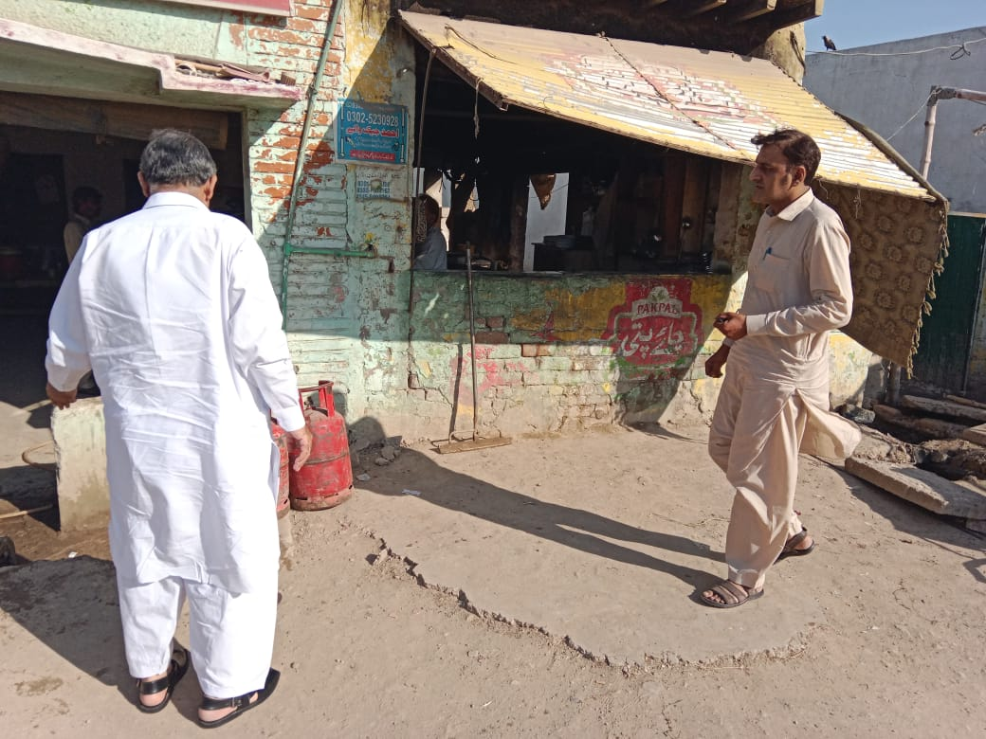
CAMPAIGN Against Dengue

Slide 55

CAMPAIGN Against Dengue

Slide 56

CAMPAIGN Against Dengue

Slide 57

CAMPAIGN Against Dengue

Slide 58

CAMPAIGN Against Dengue

Slide 59

CAMPAIGN Against Dengue

Slide 60

CAMPAIGN Against Dengue

Slide 61

CAMPAIGN Against Dengue

Slide 62

CAMPAIGN Against Dengue

Slide 63

CAMPAIGN Against Dengue

Slide 64

CAMPAIGN Against Dengue

Slide 65

CAMPAIGN Against Dengue

Slide 66

CAMPAIGN Against Dengue

Slide 67

CAMPAIGN Against Dengue

Slide 68

CAMPAIGN Against Dengue

Slide 69

CAMPAIGN Against Dengue

Slide 70

CAMPAIGN Against Dengue

Slide 71

CAMPAIGN Against Dengue

Slide 72

DRAIN CLEANING PG

Slide 73

DRAIN CLEANING PG

Slide 74

DRAIN CLEANING PG

Slide 75

DRAIN CLEANING PG

Slide 76

DRAIN CLEANING PG

Slide 77

DRAIN CLEANING PG

Slide 78

HIGHWAY WORK PG

Slide 79

HIGHWAY WORK PG

Slide 80

HIGHWAY WORK PG

Slide 81

HIGHWAY WORK PG

Slide 82

HIGHWAY WORK PG

Slide 83

HIGHWAY WORK PG

Slide 84

HIGHWAY WORK PG

Slide 85

HIGHWAY WORK PG

Slide 86

HIGHWAY WORK PG

Slide 87

PRICE CONTROL ACTIVITIES

Slide 88

PRICE CONTROL ACTIVITIES

Slide 89

PRICE CONTROL ACTIVITIES

Slide 90

PRICE CONTROL ACTIVITIES

Slide 91

PRICE CONTROL ACTIVITIES

Slide 92

PRICE CONTROL ACTIVITIES

Slide 93

PRICE CONTROL ACTIVITIES

Slide 94

PRICE CONTROL ACTIVITIES

Slide 95

PRICE CONTROL ACTIVITIES

Slide 96

PRICE CONTROL ACTIVITIES

Slide 97

PRICE CONTROL ACTIVITIES

Slide 98

PRICE CONTROL ACTIVITIES

Slide 99

PRICE CONTROL ACTIVITIES

Slide 100

PRICE CONTROL ACTIVITIES

Slide 101

PRICE CONTROL ACTIVITIES

Slide 102

PRICE CONTROL ACTIVITIES

Slide 103

PRICE CONTROL ACTIVITIES

Slide 104

THQ TEHSIL PIDNIGHEB VISIT

Slide 105

THQ TEHSIL PIDNIGHEB VISIT

Slide 106

THQ TEHSIL PIDNIGHEB VISIT

Slide 107

THQ TEHSIL PIDNIGHEB VISIT

Slide 108

THQ TEHSIL PIDNIGHEB VISIT

Slide 109

THQ TEHSIL PIDNIGHEB VISIT

Slide 110

THQ TEHSIL PIDNIGHEB VISIT

Slide 111

THQ TEHSIL PIDNIGHEB VISIT

Slide 112

THQ TEHSIL PIDNIGHEB VISIT

Slide 113

THQ TEHSIL PIDNIGHEB VISIT

Slide 114

THQ TEHSIL PIDNIGHEB VISIT

Slide 115

THQ TEHSIL PIDNIGHEB VISIT

Slide 116

THQ TEHSIL PIDNIGHEB VISIT

Slide 117

THQ TEHSIL PIDNIGHEB VISIT

Slide 118

THQ TEHSIL PIDNIGHEB VISIT

Slide 119

THQ TEHSIL PIDNIGHEB VISIT

Slide 120

THQ TEHSIL PIDNIGHEB VISIT

Slide 121

THQ TEHSIL PIDNIGHEB VISIT

Slide 122

THQ TEHSIL PIDNIGHEB VISIT

